Slide 1
ML Visuals
By dair.ai
https://github.com/dair-ai/ml-visuals
Notes:
ML Visuals is a new collaborative effort to help the machine learning community in improving science communication by using more professional, compelling and adequate visuals and figures. You are free to use the visuals in your presentations or blog posts. You don’t need to ask permission to use any of the visuals but it will be nice if you can provide credit to the designer/author (author information found in the slide notes).
This is a project made by the dair.ai community and maintained in this GitHub repo. Our community members will continue to add more common figures and basic elements in upcoming versions. Think of this as free and open artefacts and templates which you can freely and easily download, copy, distribute, reuse and customize to your own needs. I am maintaining this set of slides on a bi-weekly basis where I will regularly organize and keep the slides clean from spam or unfinished content.
IMPORTANT NOTE: Please don’t request editing permission if you do not plan to add anything to the slides. If you want to edit the slides for your own purposes, just make a copy of the slides.
Contributing: To add your own custom figures, simply add a new slide and reuse any of the basic visual components (remember to request edit permissions). We encourage authors/designers to add their visuals here and allow others to reuse them. Make sure to include your author information (in the notes section of the slide) so that others can provide the proper credit if they use the visuals elsewhere (e.g. blog/presentations). Add your name and email just in case someone has any questions related to the figures you added. Also, provide a short description of your visual to help the user understand what it is about and how they can use it. If you need "Edit" permission, just click on the "request edit access" option under the "view only" toolbar above or send me an email at ellfae@gmail.com. If you have editing rights, please make sure not to delete any of the work that other authors have added. You can try to improve it by creating a new slide and adding that improved version (that’s actually encouraged).
Downloading a figure from any of the slides is easy. Just click on File→Download→(choose your format).
If you need help with customizing a figure or have an idea of something that could be valuable to others, we can help. Just open an issue here and we will do our best to come up with the visual. Thanks.
Feel free to ask us anything related to this project in our Slack group.

Slide 2
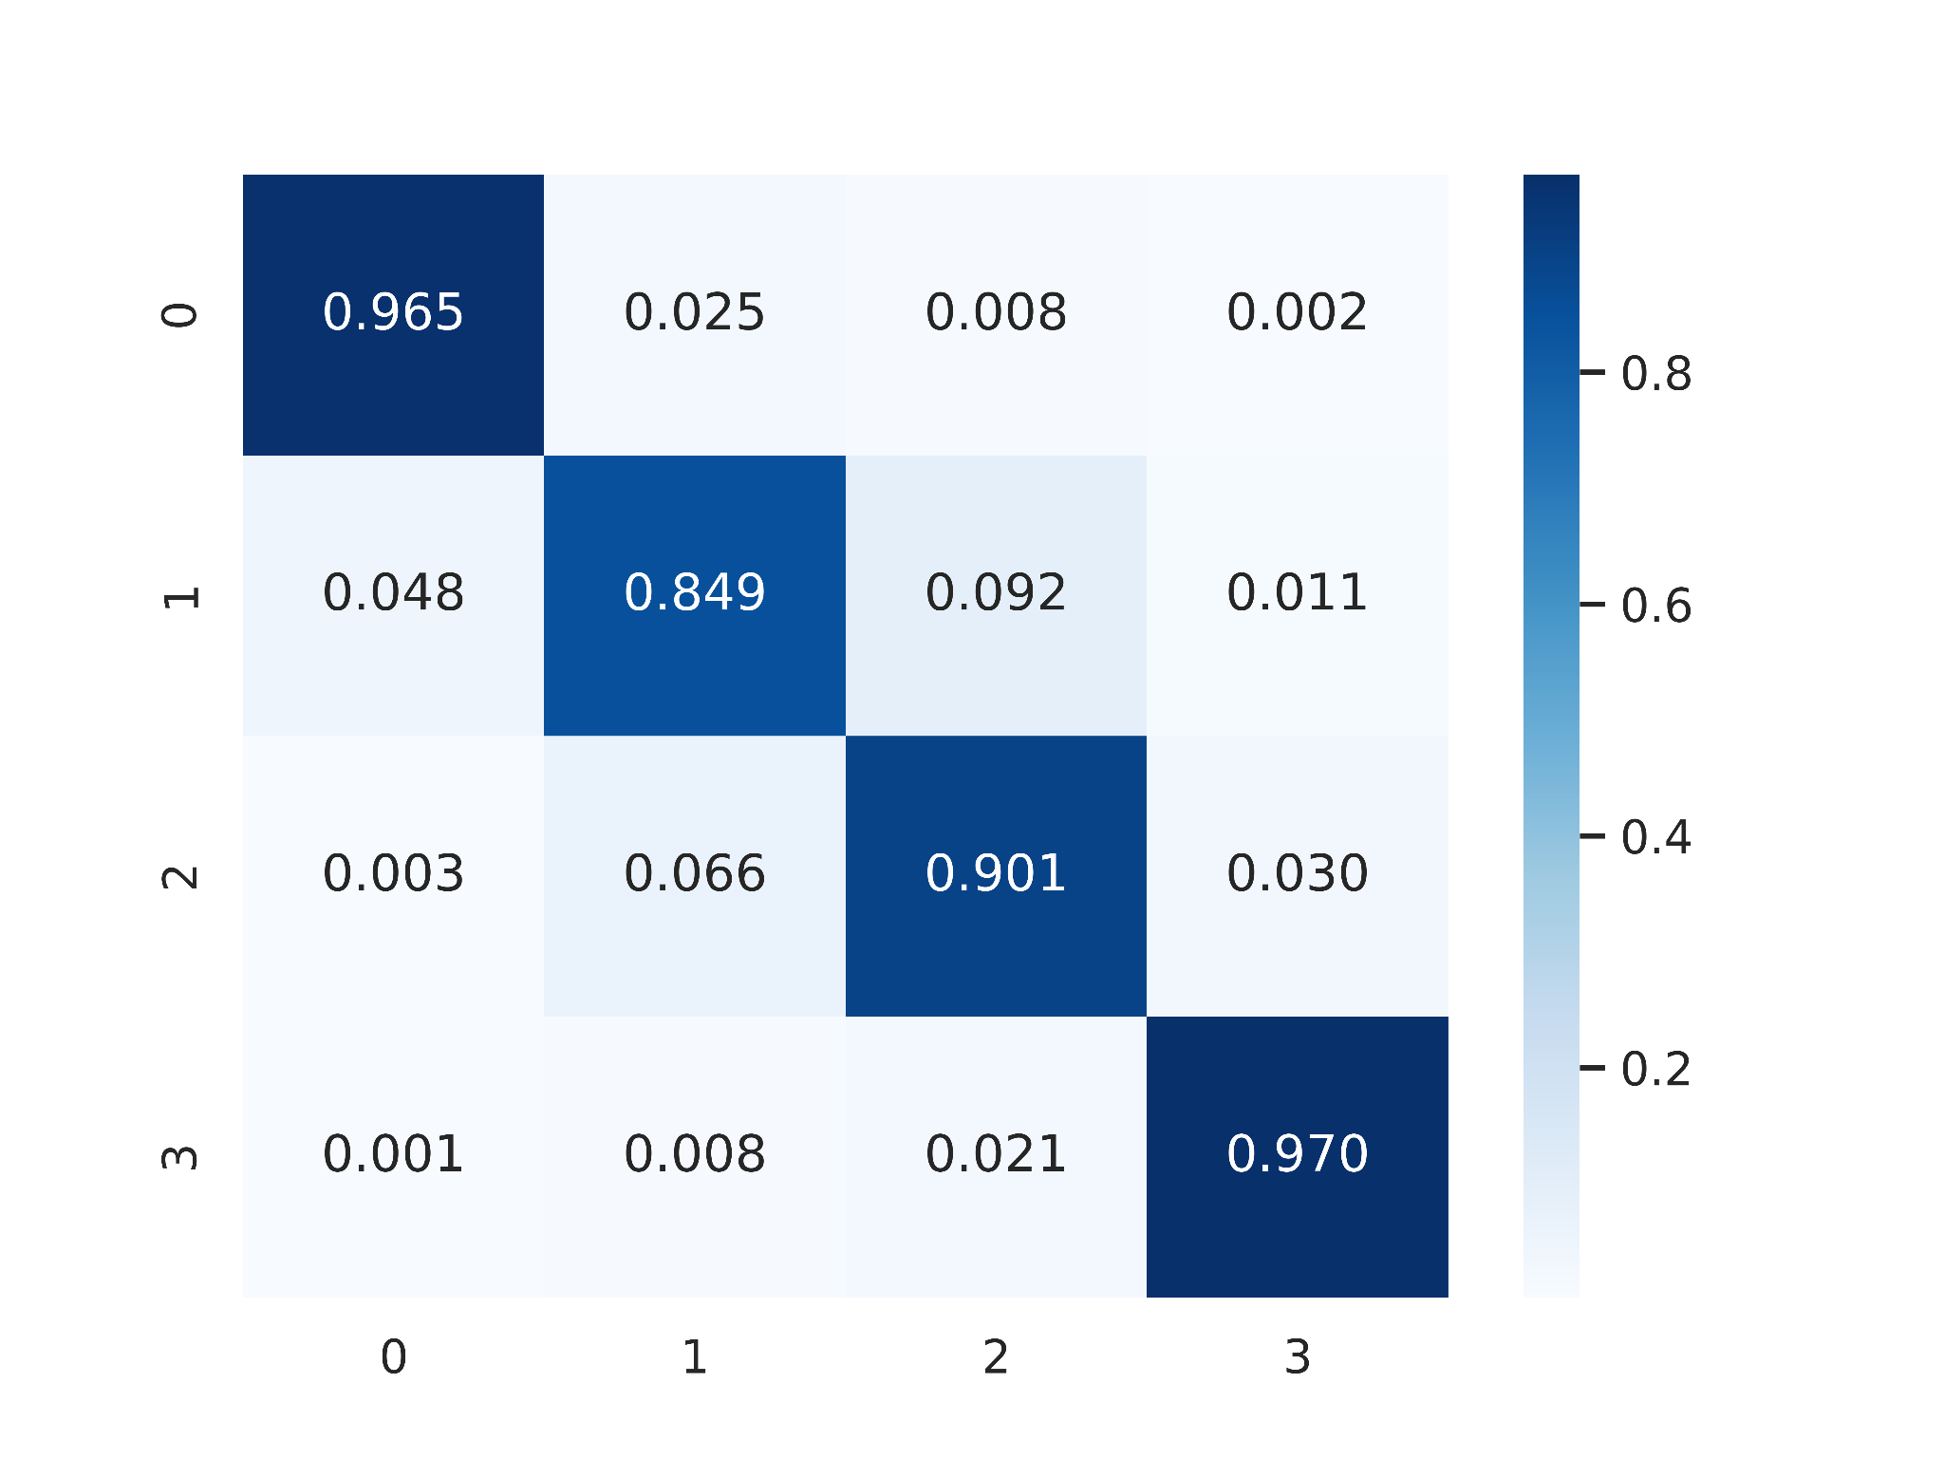

Slide 3
BCI的应用背景
应用挑战
高变异性
其他方法的不足（链状，单维度，手工设计特征）
提出方法解决问题（多维度，端到端，自动学习）
数据集及问题概述（Visual Stimulus)
生成EEG（时域、频域）地形图
DSNN的提出（多维度）
结果
与传统方法、最新深度学习方法比较（准确率）
分析CNN的工作原理（反卷积）
分析Attention value与ERP和ERD/ERS关系
讨论
DSNN的优越性（SS,TS)
Subject-dependent场景下的结果（Subject-Independent的困难以及必要性）
端到端框架的实现
对image-based方法的分析

Slide 4
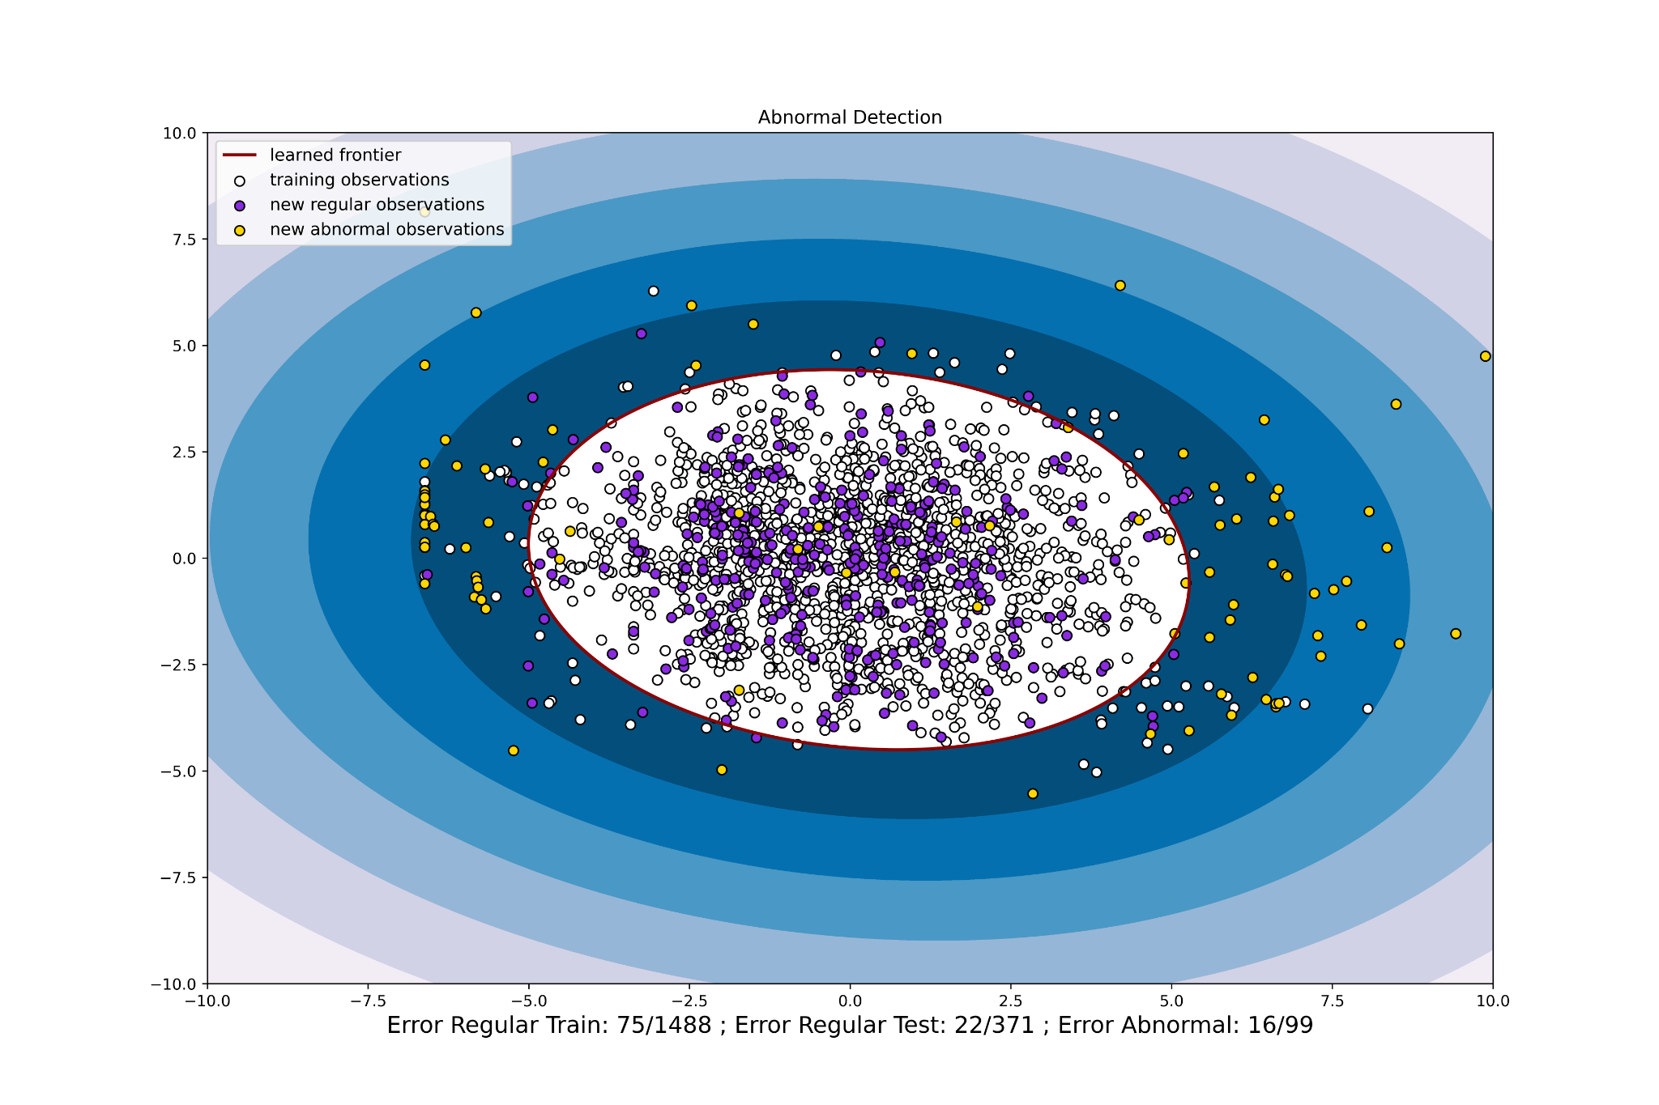
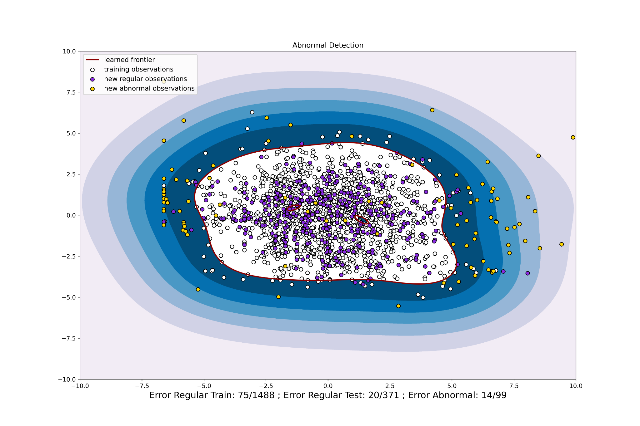
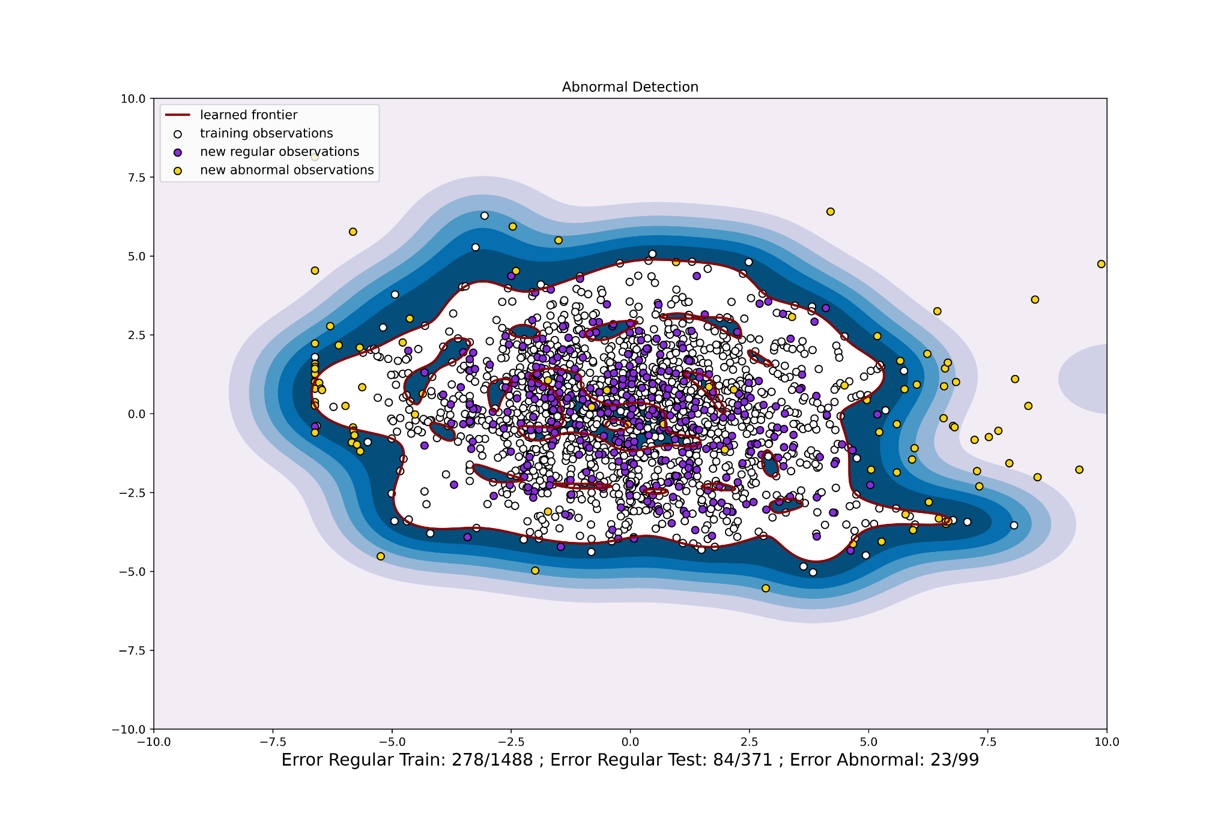
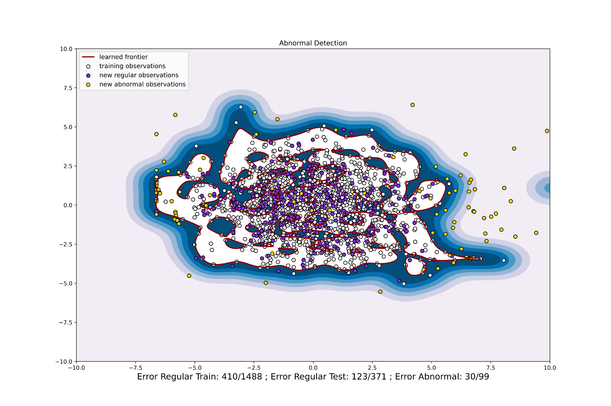
sigma=0.01
sigma=0.1
sigma=0.5
sigma=1

Slide 5
Original Space
Feature Space
Decision Hyperplane
Zero Point

Slide 6
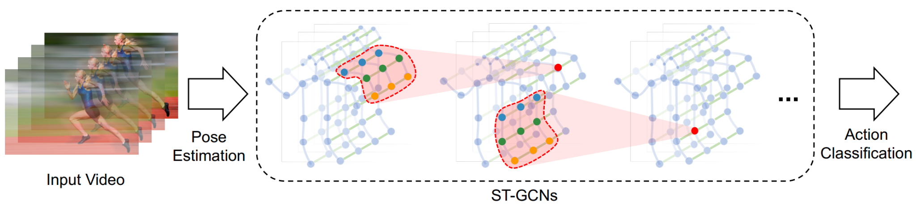

Lightweight Openpose
Input Video
Fall
Dection
ST-GCNs

Slide 7
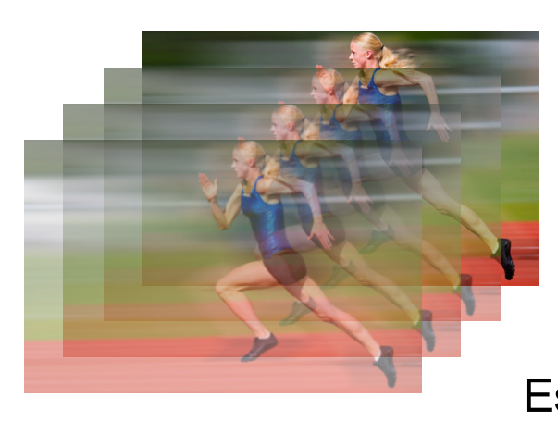
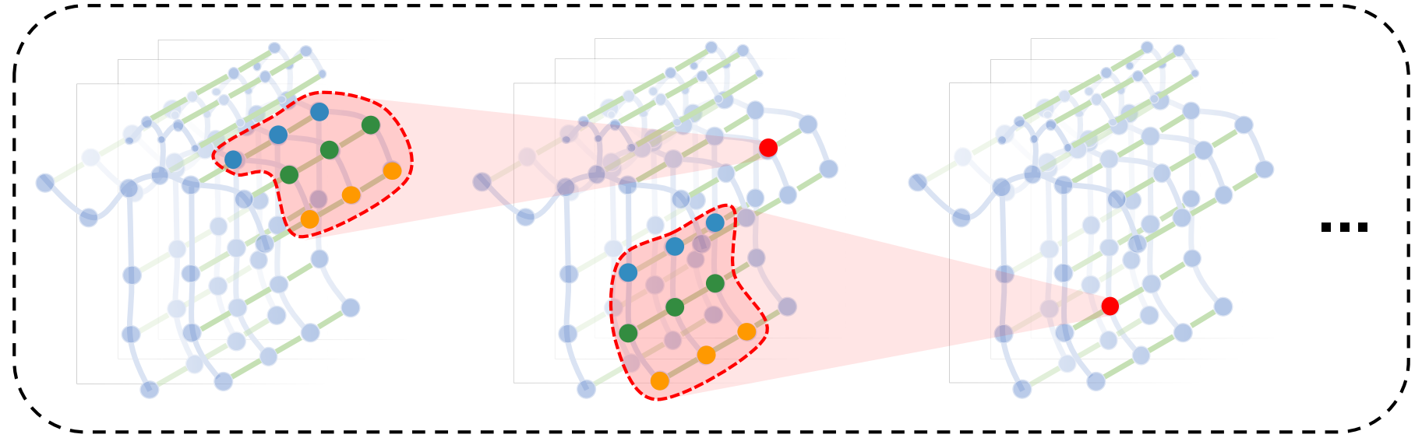
Lightweight Openpose
Video Stream
ST-GCNs
Fall Detection

Slide 8
Video Stream
Skeleton Extraction
Fall
Detection
Email
Alert
Abnormal
Normal

Slide 9
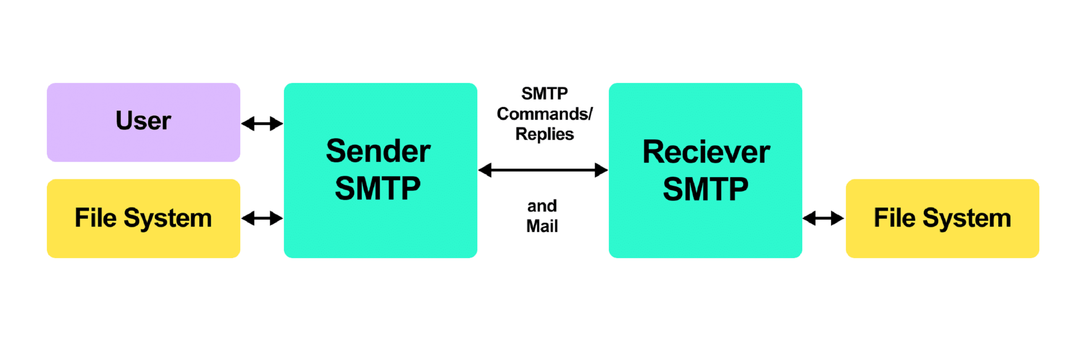
SMTP
Commands/Replies
User
Sender
SMTP
Receiver
SMTP
File System
Mail
File System

Slide 10
Video Stream
Skeleton Extraction
Fall
Detection
Email
Alert
Abnormal
Normal

Slide 11

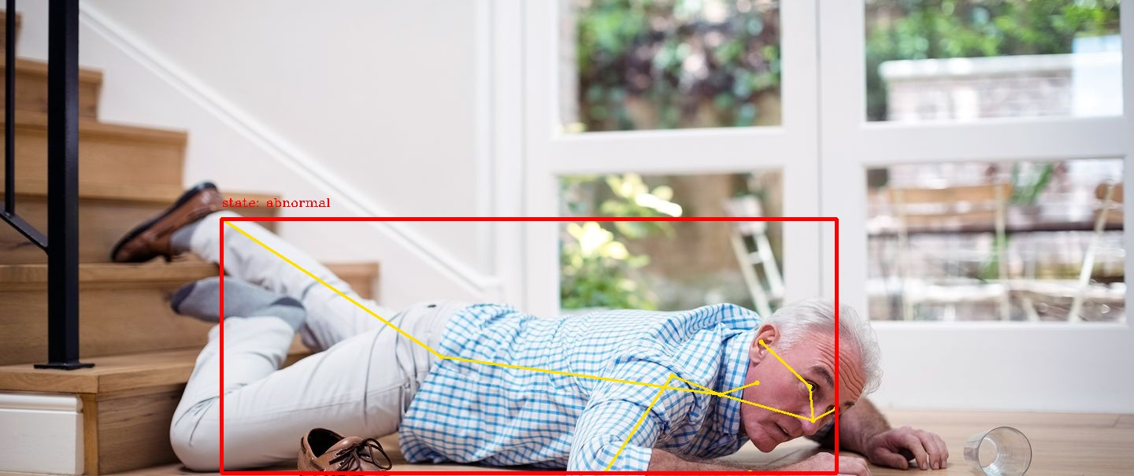
Conv1
Number Pafs
Conv1-512
Conv3-128
Conv1-128
Conv3-128
dia=2
Conv3-128
Conv3-128
Conv1-128
Conv1
Number Keypoints
Conv1-512
Skeleton
Image

Slide 12
Feature Space
f(x) = 1 Unpurchased
ΔF₁ו
Decision Hyperplane f(x) = 0
f(x) = -1
Purchased

Slide 13
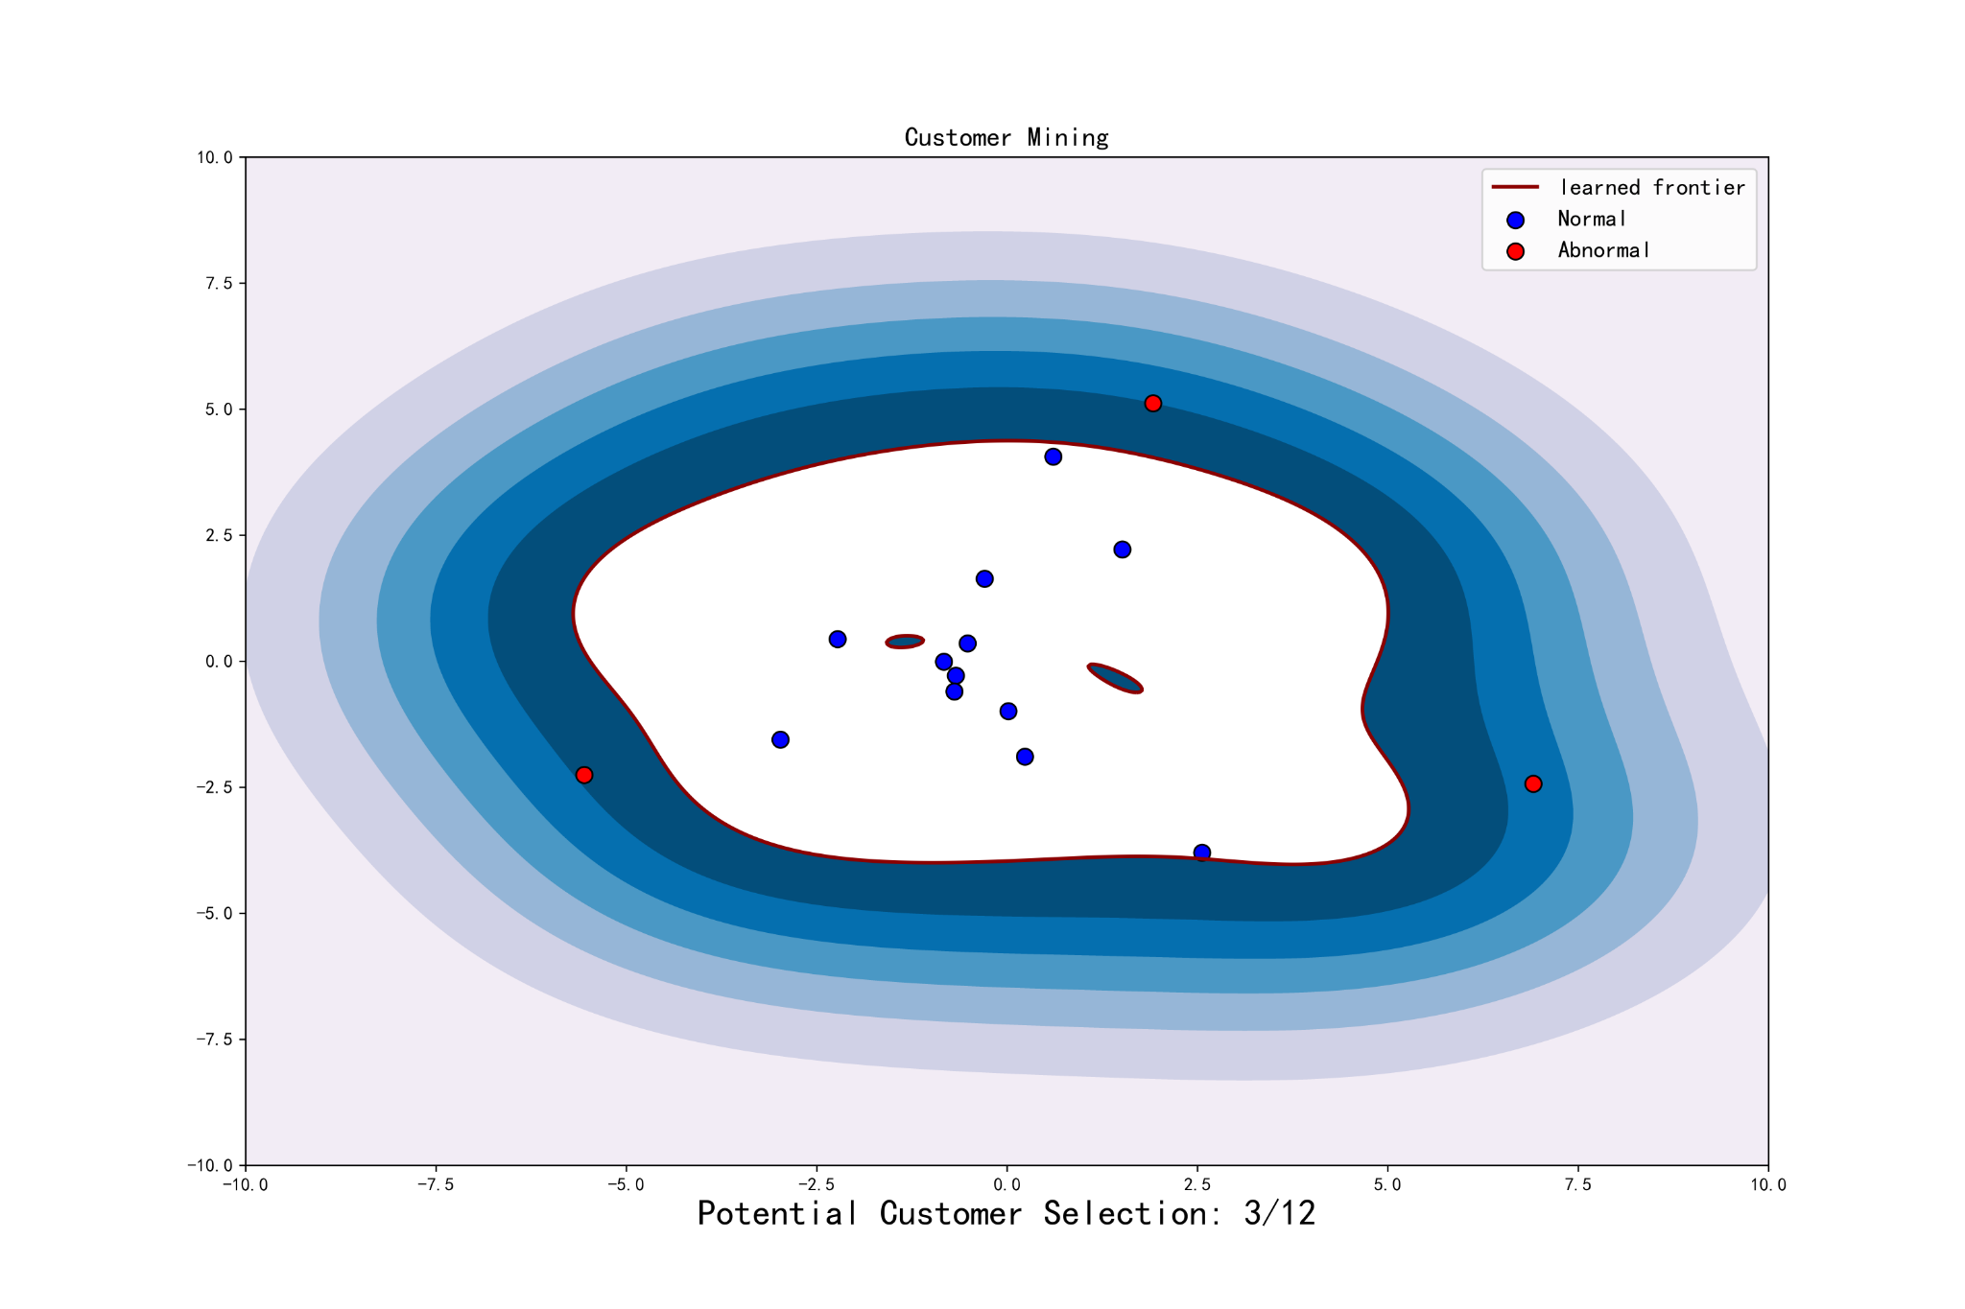

Slide 14
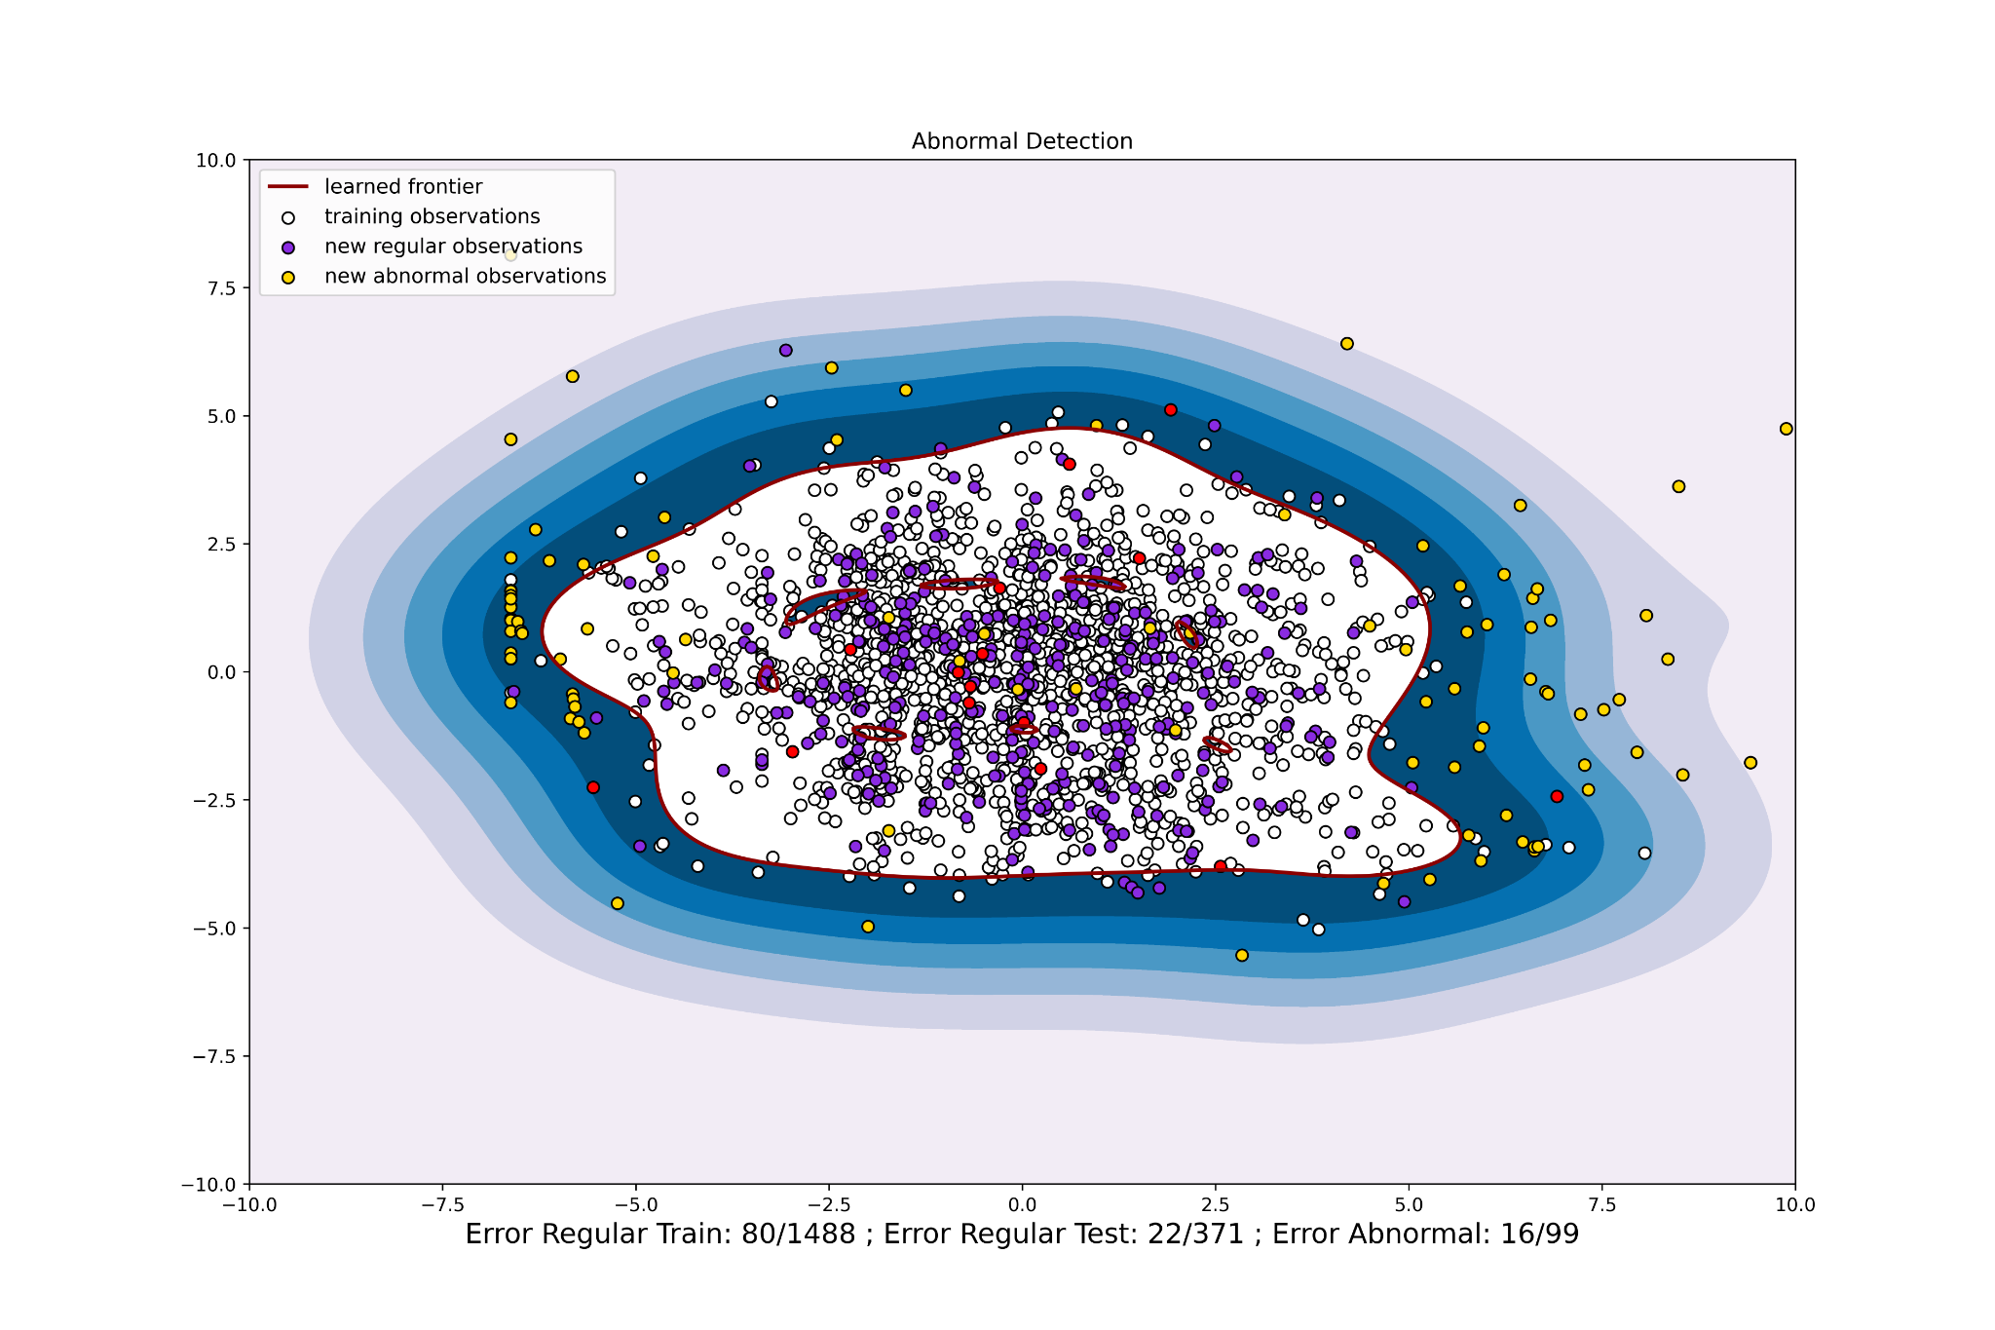

Slide 15
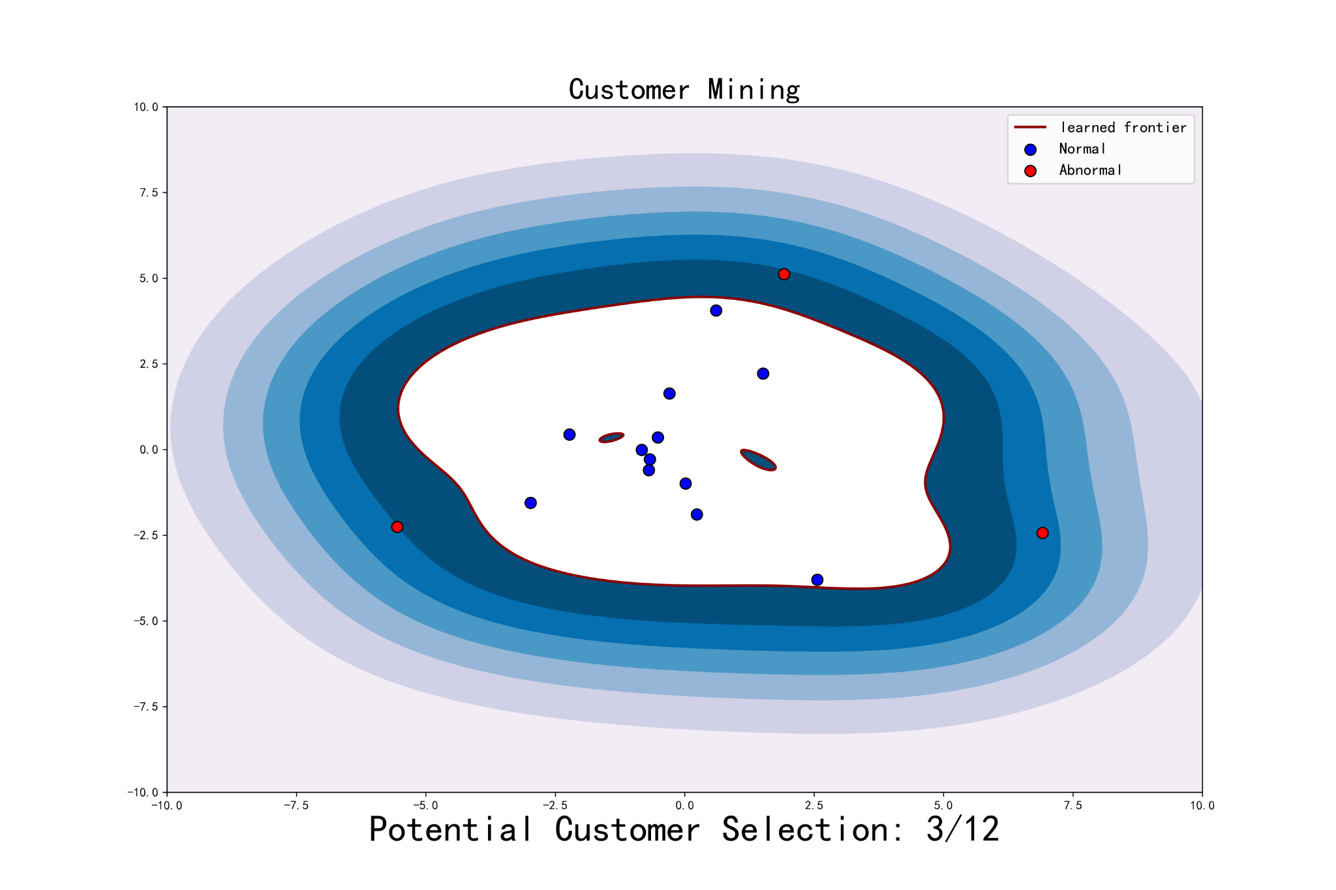

Slide 16
Learning Spatial-Spectral-Temporal EEG Representations with Dual-Stream Neural Networks for Motor Imagery
WEIJIAN MAI
For
Representation

Slide 17
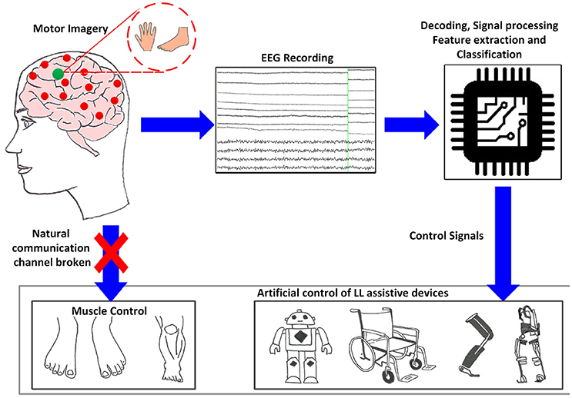
EEG-Based BCI的应用背景
运动康复
情感识别
机器人
脑控轮椅
Notes:
基于EEG的脑机接口能够使用户通过大脑与外界进行交流，最初用于运动性残疾患者的运动康复，近年出现了对于普通用户的情感脑机接口

Slide 18
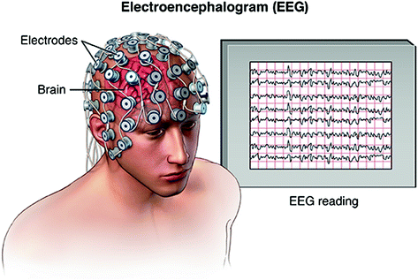
BCI的应用挑战
High Variation
Subject-
Independent
Intra-Subject
Inter-Subject
Notes:
（挑战）分类的本质：找到大脑活动与EEG的对应关系，不变表示

Slide 19
BCI的应用挑战
Notes:
（挑战）目前方法的不足：传统方法（依赖hand-craft features), SOTA方法（单维度），难以适用于Subject-Independent场景

Slide 20
Motor Imagery
Rest
Rest
ERP
PSD
0~1s
1~3s
Time
Visual
Stimulus
Visual
Stimulus
T0
T1/T2
T0
T1/T2

Slide 21
An EEG Trial
Rest
Motor Imagery
Rest
4-sec
Time
Visual
Stimulus
Visual
Stimulus

Slide 22
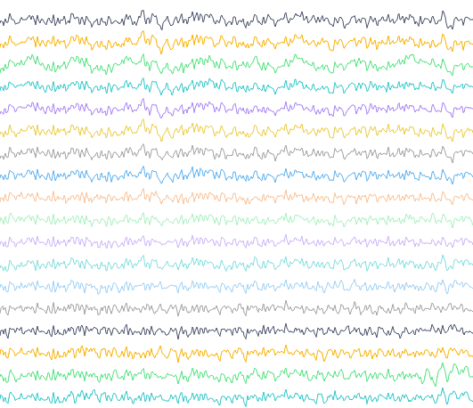

Slide 24
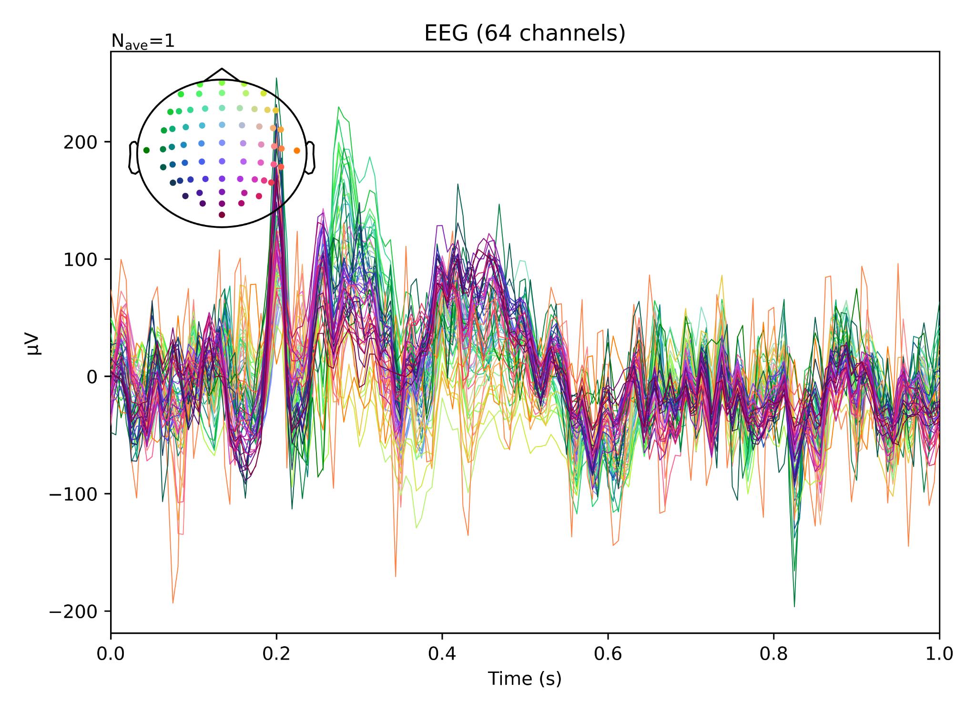
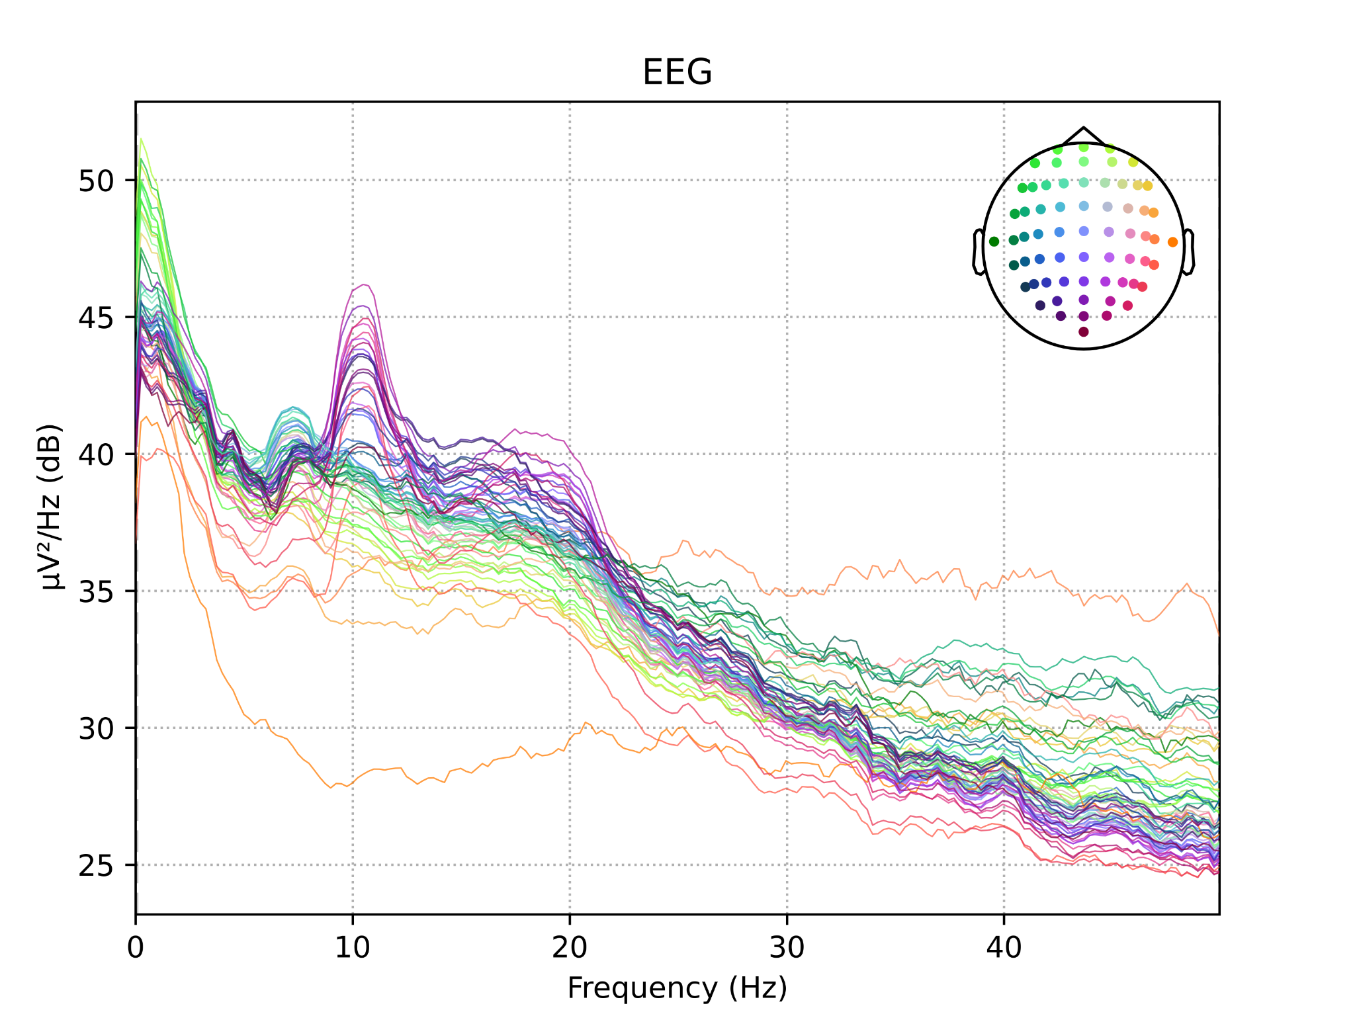
L
L
A
C
L
L
A
C
C
L
L
A
C
L
L
A
C
L
L
A
L
L
A
C
L
L
A
C
C
L
L
A
C
L
L
A
C
L
L
A

Slide 25



L
L
A
C
L
L
A
C
C
L
L
A
C
L
L
A
C
Spatial-Stream
L
L
A
L
L
A
C
L
L
A
C
C
L
L
A
C
L
L
A
C
Spectral-Stream
L
L
A

Slide 26
(a) EEG Topographic Maps Generation
L
L
A
Spatial-Stream
C
C
L
L
A
C
L
L
A
C
EEG of all channels in time domain
(0-1s, downsampling to 100Hz)
Spatial Topographic Maps
(25 frames)
L
L
A
L
L
A
C
C
L
L
A
C
L
L
A
C
Spectral-Stream
L
L
A
EEG of all channels in frequency domain
(0-50Hz, average of 0-4s (one trial))
Spectral Topographic Maps
(25 frames)

Slide 27
Temporal-Stream
L
L
A
C
C
L
L
A
C
L
L
A
C
EEG of all channels in time domain
(0-1s, downsampling to 100Hz)
Spatial Topographic Maps
(25 frames)
L
L
A
Spectral-Stream
L
L
A
C
Softmax
Layer
C
L
L
A
C
L
L
A
FC
Layer
C
L
L
A
EEG of all channels in frequency domain
(0-50Hz, average of 0-4s (one trial))
Spectral Topographic Maps
(25 frames)
CNN
BiLSTM
ANN
EEG Topographic Maps Generation
(b) Spatial-Spectral-Temporal Feature Learning

Slide 28
Temporal-Stream
L
L
A
C
960ms
C
L
L
A
80ms
C
40ms
L
L
A
0ms
C
EEG of all channels in time domain
(0-1s, downsampling to 100Hz)
Spatial Topographic Maps
(25 frames)
L
L
A
Spectral-Stream
L
L
A
C
Softmax
Layer
C
L
L
A
48Hz
C
4Hz
L
L
A
2Hz
C
FC
Layer
0Hz
L
L
A
EEG of all channels in frequency domain
(0-50Hz, average of 0-4s (one trial))
Spectral Topographic Maps
(25 frames)
CNN
Bi-LSTM
ANN
(a) EEG Topographic Maps Generation
(b) Spatial-Spectral-Temporal Feature Learning

Slide 29
Temporal-Stream
L
L
A
C
C
L
L
A
C
L
L
A
C
Amplitude of all channels in time domain
(0-1s, downsampling to 100Hz)
Spatial Topographic Maps
(25 frames)
L
L
A
Spectral-Stream
L
L
A
C
Softmax
Layer
C
L
L
A
C
L
L
A
FC
Layer
C
L
L
A
PSD of all channels in frequency domain
(0-50Hz, average of 0-4s (one trial))
Spectral Topographic Maps
(25 frames)
CNN
Bi-LSTM
ANN
(a) EEG Topographic Maps Generation
(b) Spatial-Spectral-Temporal Feature Learning

Slide 30
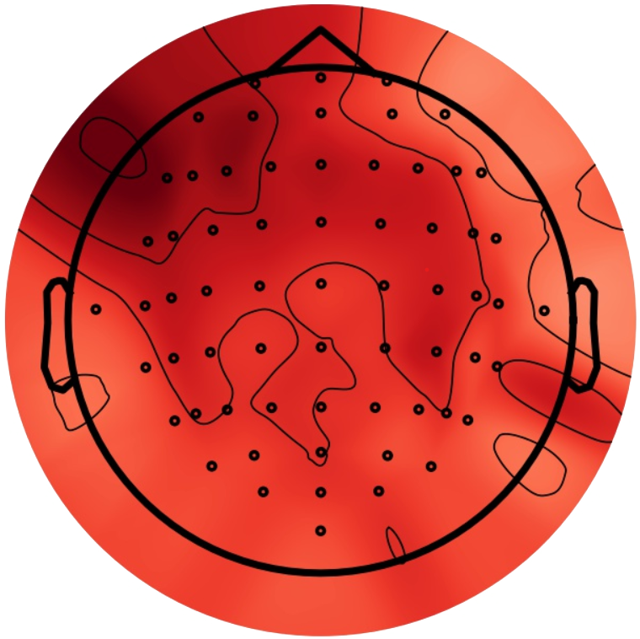

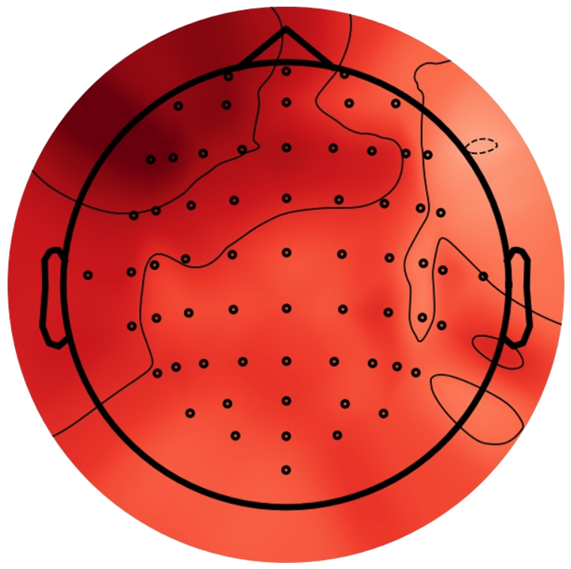
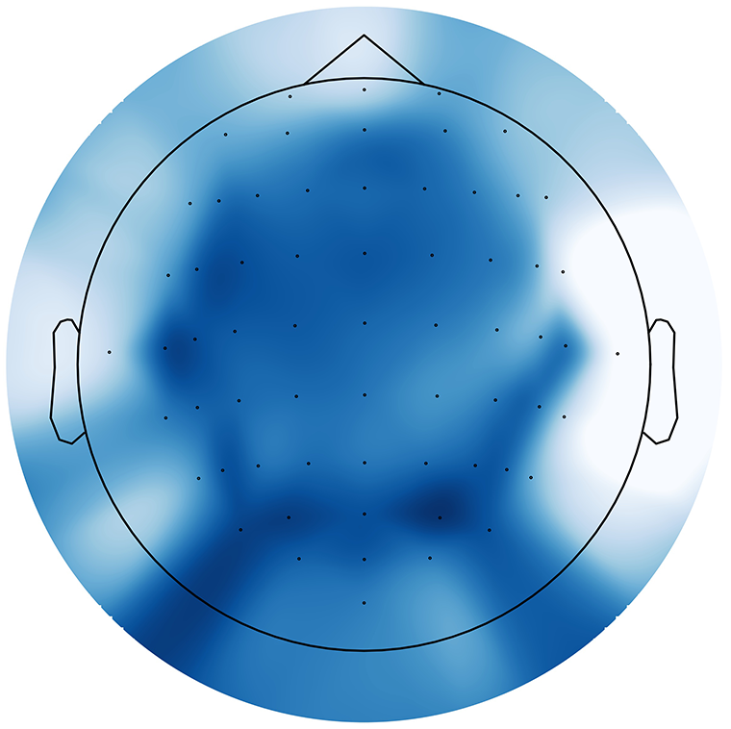
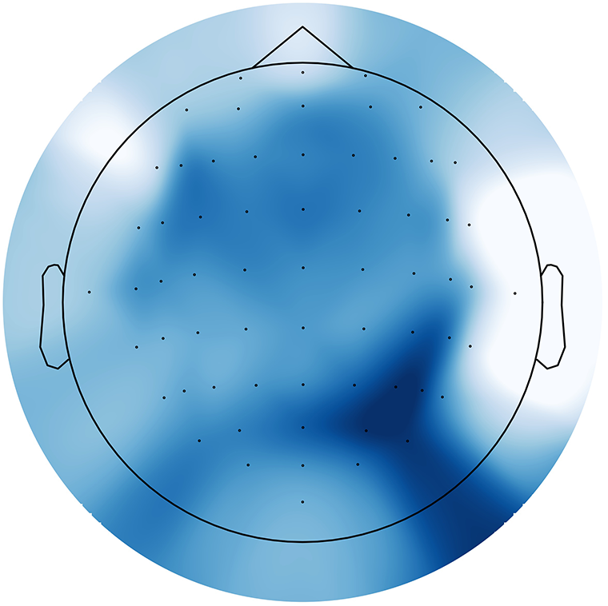
Bicubic
980ms
940ms
100ms
60ms
20ms
EEG of all channels in time domain (0-1s, downsampling to 100Hz)
Amplitude Distribution
(Interval: 40ms)
Temporal EEG Topographic Maps
(25 frames)
Bicubic
49Hz
47Hz
5Hz
3Hz
1Hz
EEG of all channels in frequency domain (0-50Hz, average of 0-4s (one trial))
Power Distribution
(Interval: 2Hz)
Spectral EEG Topographic Maps
(25 frames)

Slide 32
C
L
L
A
L
L
A
C
C
L
L
A
C
L
L
A
C
L
L
A
L
L
A
C
L
L
A
C
C
L
L
A
C
L
L
A
C
L
L
A

Slide 33
Temporal-Stream
L
L
A
C
Bicubic
C
L
L
A
1000ms
120ms
C
80ms
L
L
A
40ms
C
Amplitude of all channels in time domain
(0-1s, downsampling to 100Hz)
Spatial Topographic Maps
(25 frames)
L
L
A
Spectral-Stream
L
L
A
C
Bicubic
C
L
L
A
Softmax
Layer
50Hz
C
6Hz
L
L
A
4Hz
C
(c) MI Classification
2Hz
L
L
A
PSD of all channels in frequency domain
(0-50Hz, average of 0-4s (one trial))
Spectral Topographic Maps
(25 frames)
CNN
RNN
ANN
(a) EEG Topographic Maps Generation
(b) DSNN for Spatial-Spectral-Temporal Representations Learning

Slide 34
Temporal-Stream
EEG (64 channels)
L
L
A
C
Bicubic
μV
C
L
L
A
1000ms
60ms
C
40ms
L
L
A
Time (s)
20ms
C
0
Amplitude of all channels in time domain
(0-1s, downsampling to 100Hz)
Spatial Topographic Maps
(50 frames)
L
L
A
Spectral-Stream
EEG (64 channels)
L
L
A
C
Bicubic
μV²/Hz (dB)
C
L
L
A
Softmax
Layer
50Hz
C
3Hz
L
L
A
2Hz
C
MI Classification
1Hz
Frequency (Hz)
L
L
A
PSD of all channels in frequency domain
(0-50Hz, average of 0-4s (one trial))
Spectral Topographic Maps
(50 frames)
CNN
RNN
ANN
EEG Topographic Map Generation
DSNN for Spatial-Spectral-Temporal Representation Learning

Slide 35
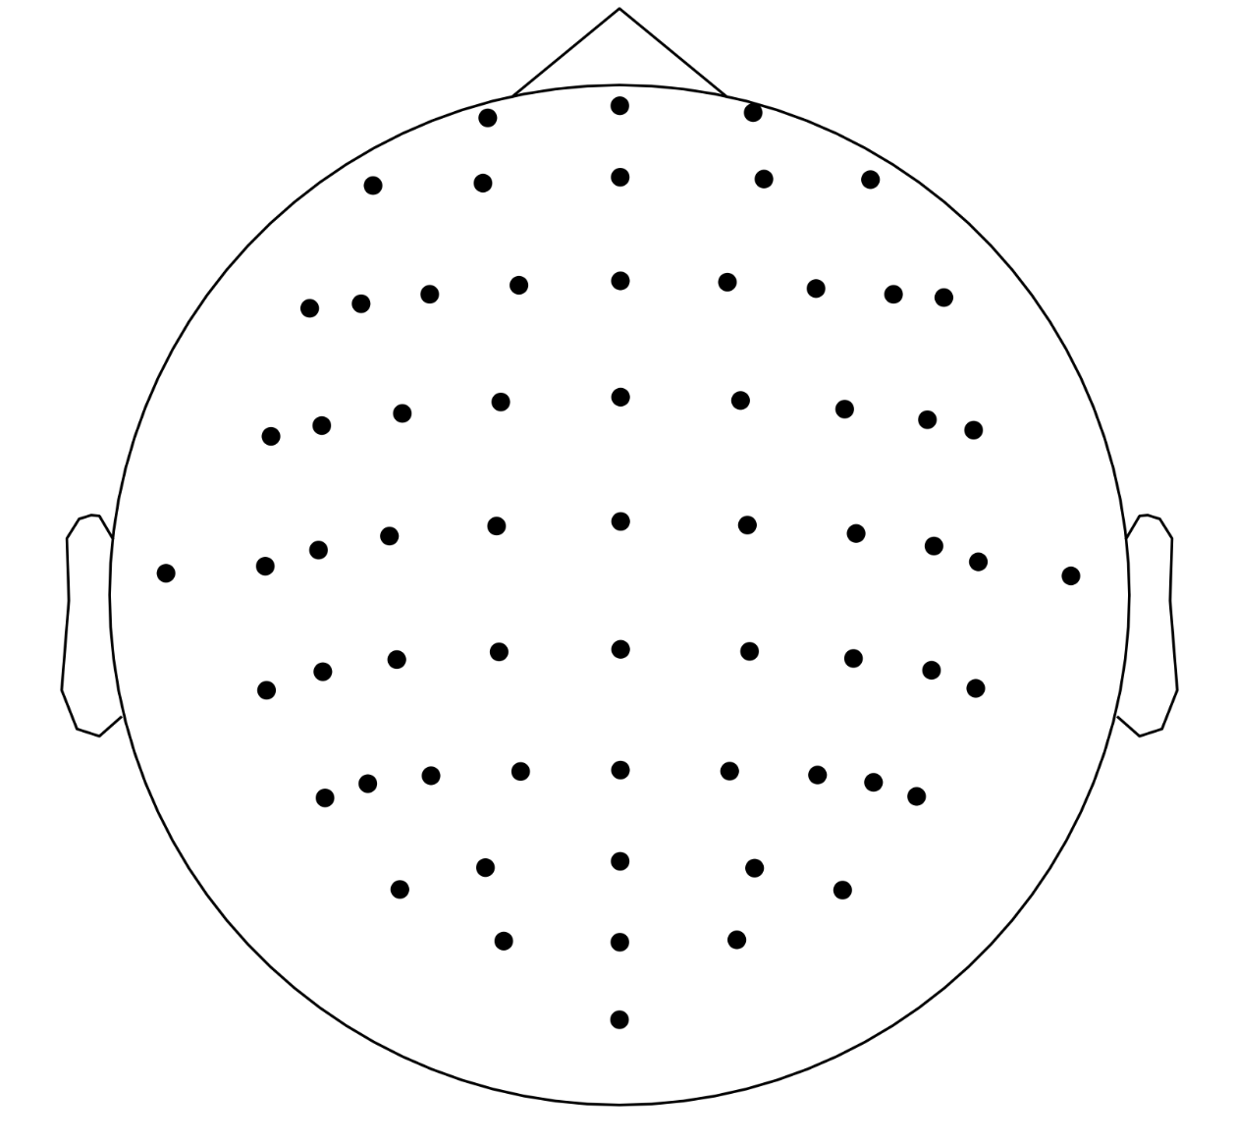
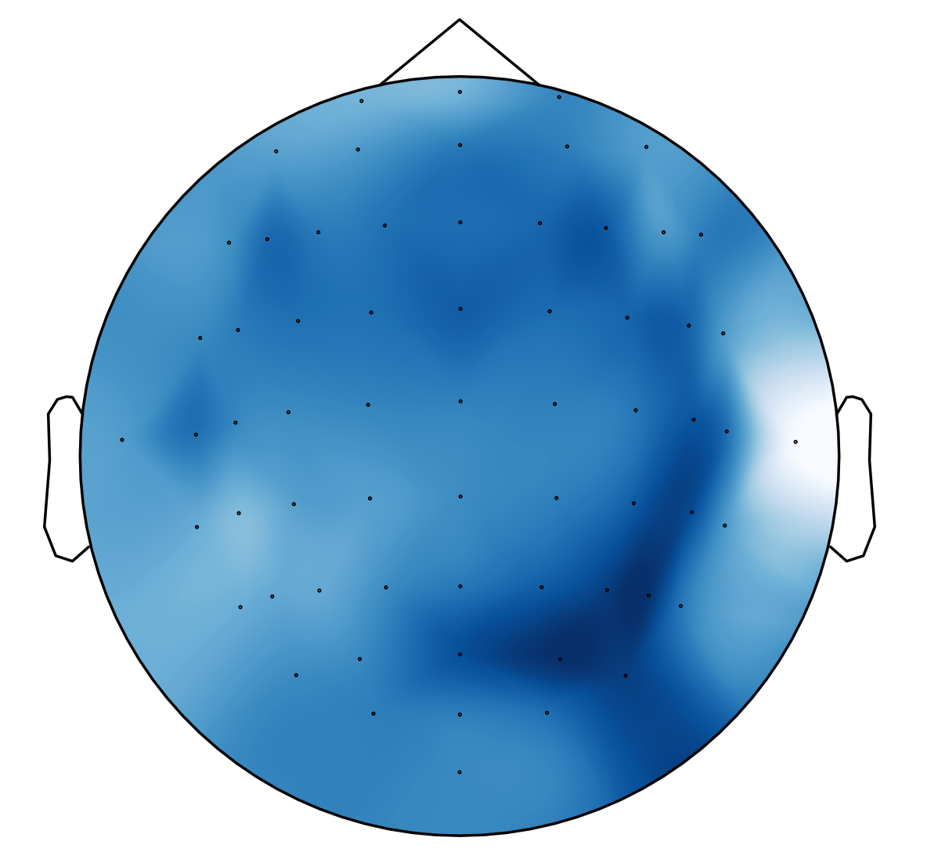

Two-dimensional
Sensor Positions
Head-like
Topographic Map
Box-like
Topographic Map

Slide 36
EEG (64 channels)
Temporal-Stream
L
L
A
200
C
Bicubic
100
μV
0
C
L
L
A
1000ms
-100
C
60ms
-200
40ms
L
L
A
0
0.2
0.4
0.6
0.8
1.0
20ms
C
Time (s)
Amplitude of all channels in time domain
(0-1s, downsampling to 100Hz)
Temporal Topographic Maps
(50 frames)
L
L
A
Spectral-Stream
EEG (64 channels)
L
L
A
50
C
45
Bicubic
40
C
μV²/Hz (dB)
L
L
A
Softmax
Layer
35
50Hz
30
C
3Hz
L
L
A
25
2Hz
C
(c) MI Classification
0
10
20
30
40
50
1Hz
Frequency (Hz)
L
L
A
PSD of all channels in frequency domain
(0-50Hz, average of 0-4s (one trial))
Spectral Topographic Maps
(50 frames)
CNN
RNN
ANN
(a) EEG Topographic Map Generation
(b) DSNN for Spatial-Spectral-Temporal Representation Learning

Slide 37
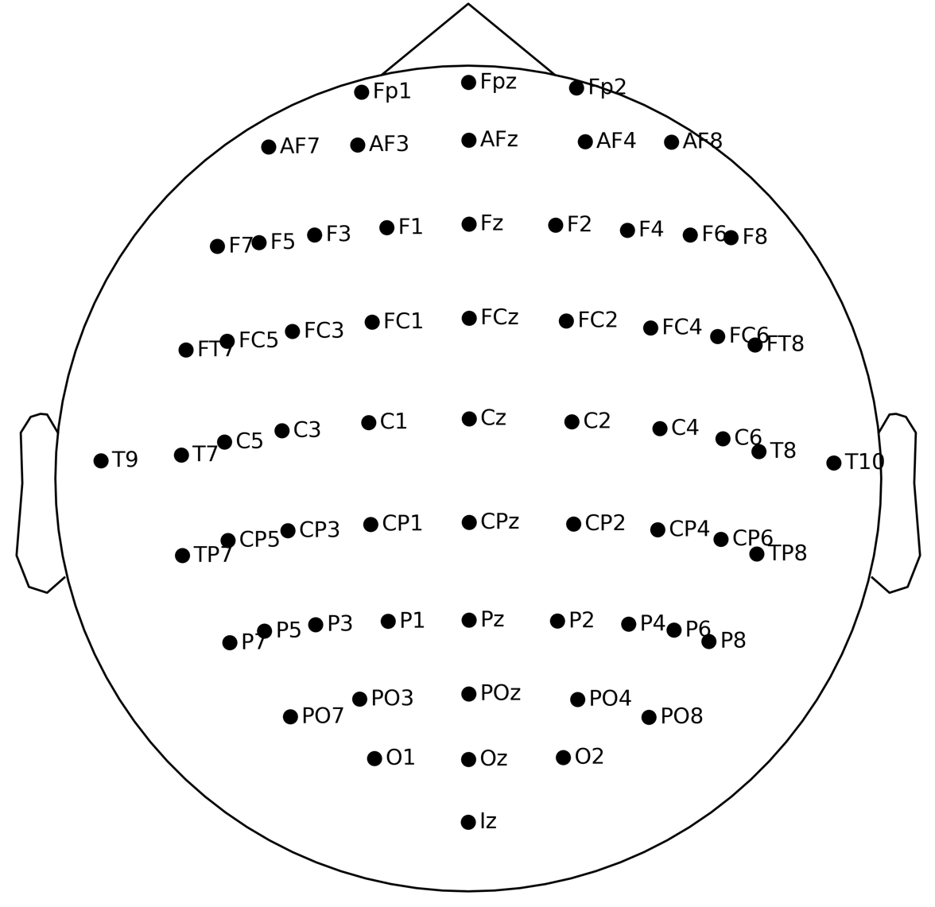
(32 x 32)
sensor positions
head-like
topographic map
box-like
topographic map

Slide 38
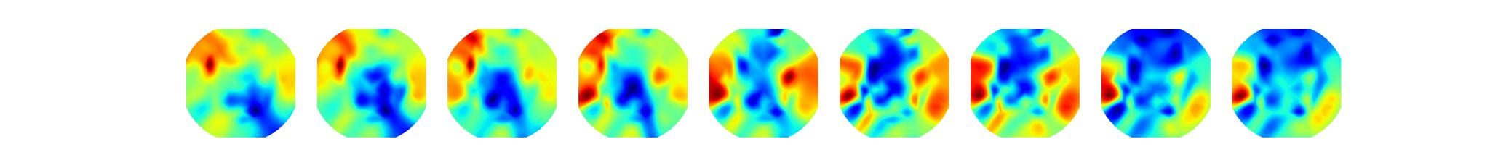
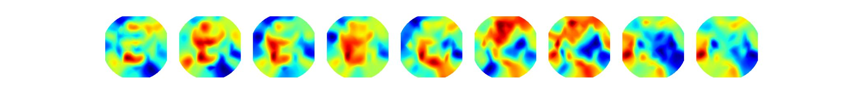
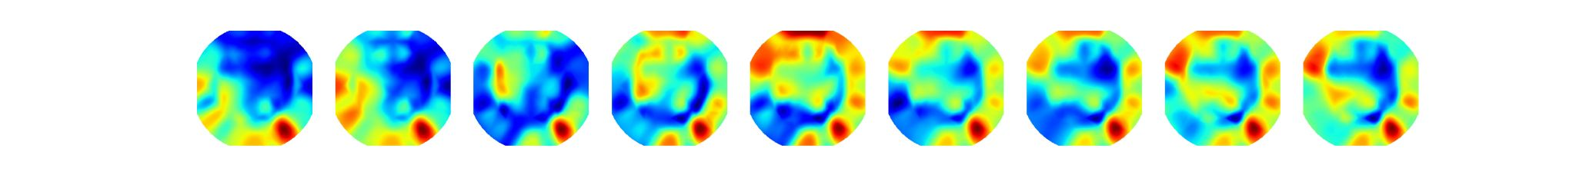
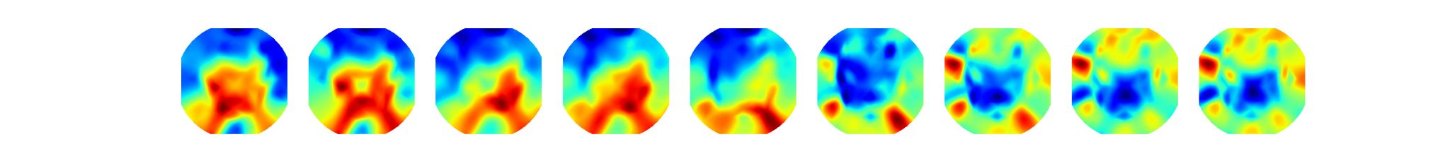
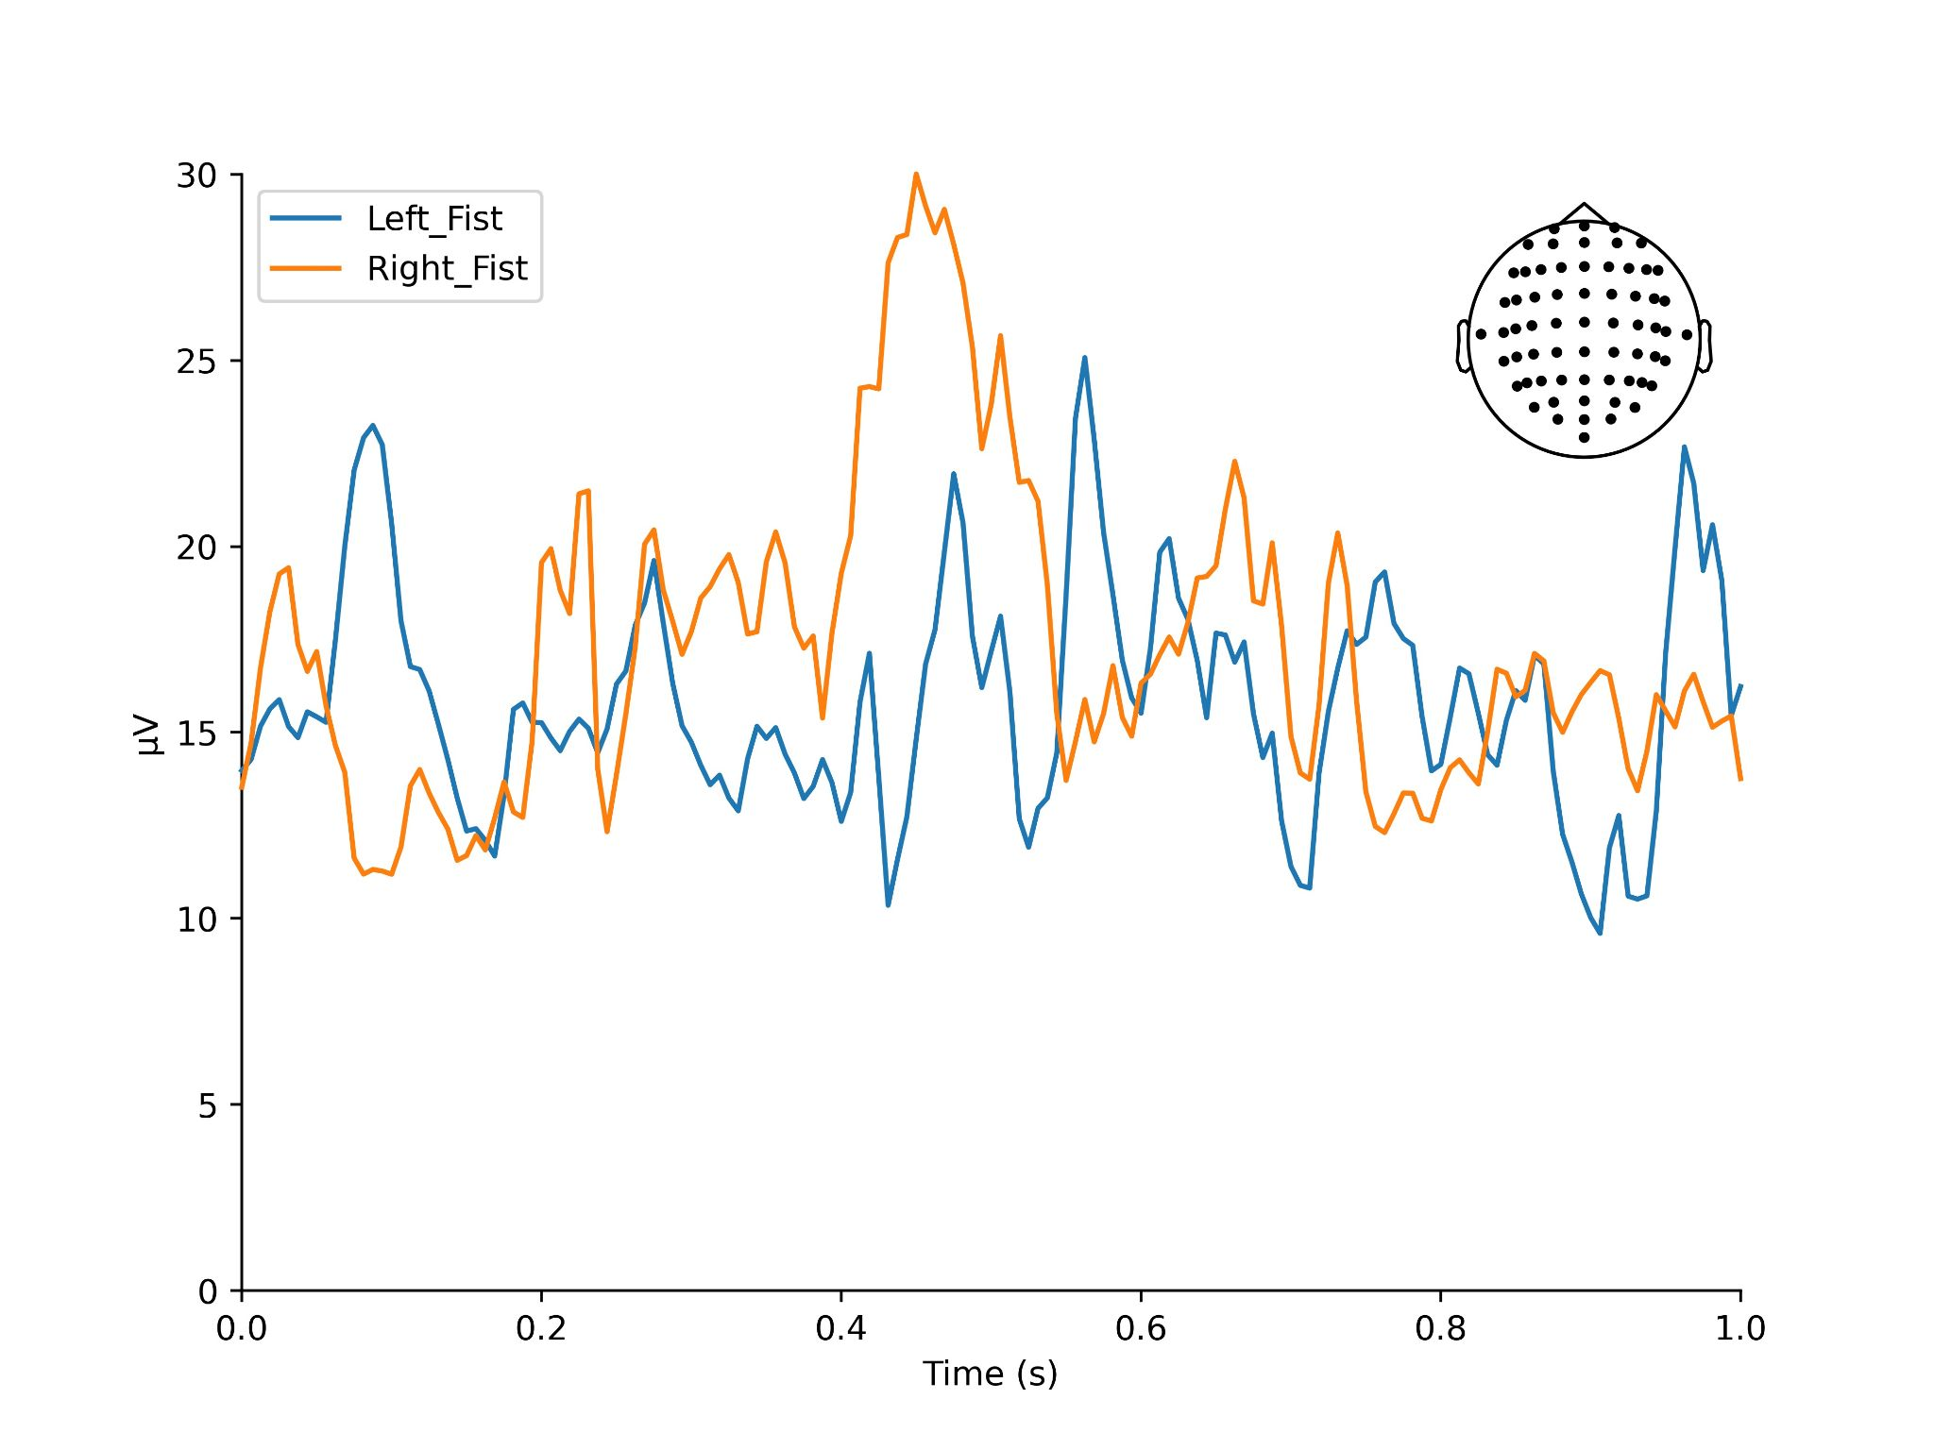
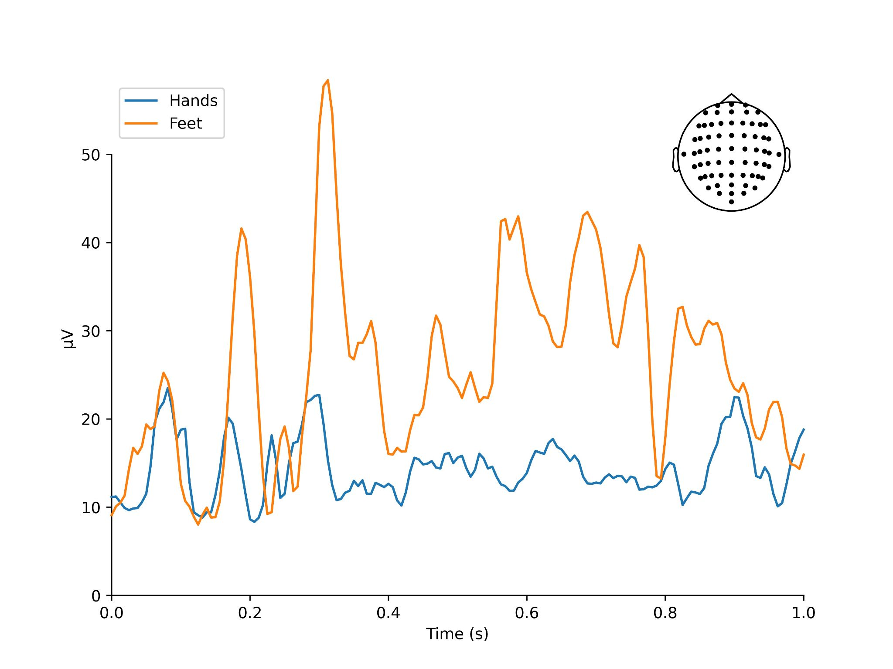
Right Fist
Both Hands
Left Fist
Both
Feet

Slide 39
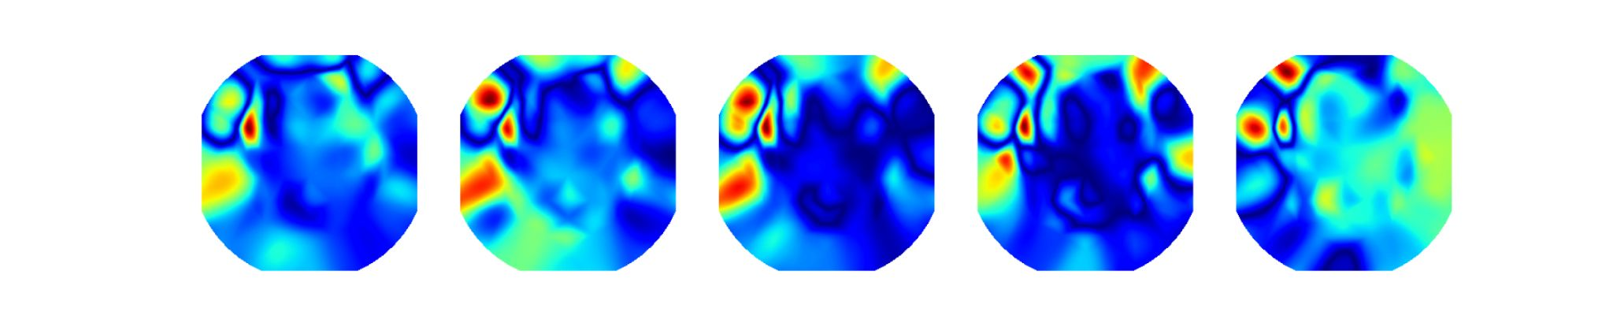
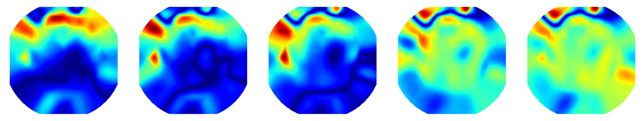
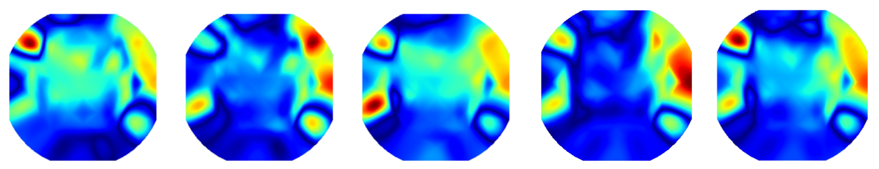
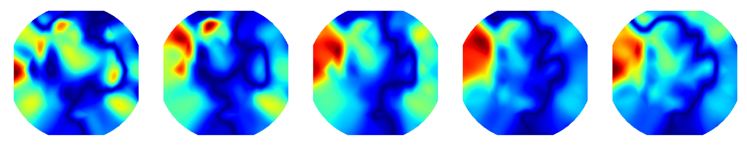
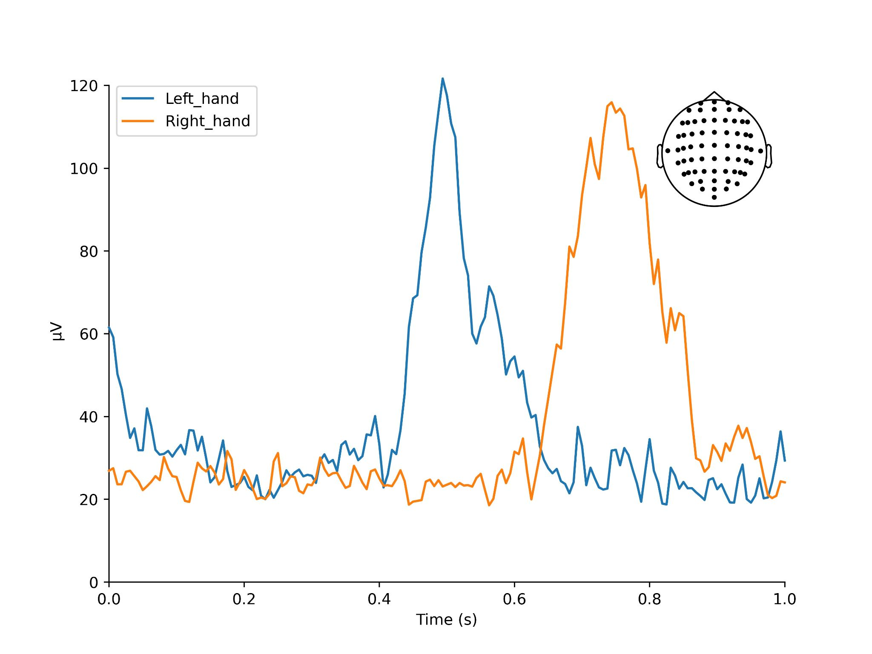
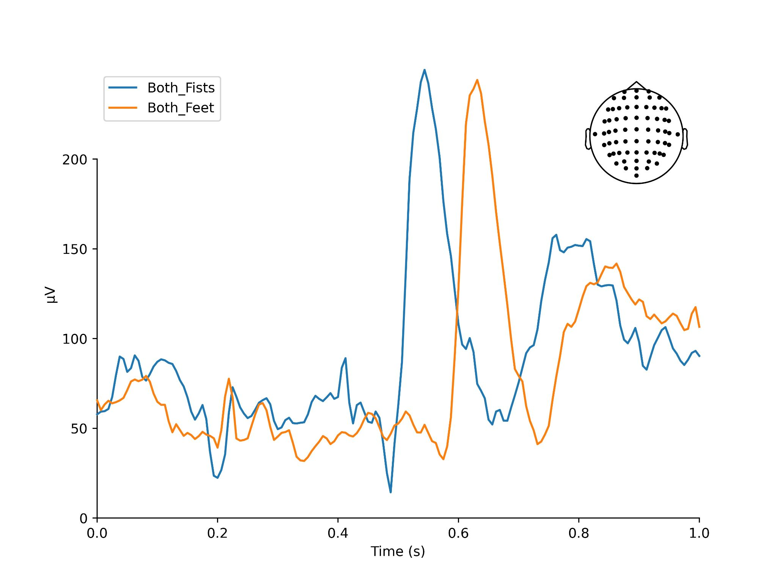
Right Fist
Both Hands
Time
Left Fist
Both
Feet
P5
P7
P5
P6

Slide 40
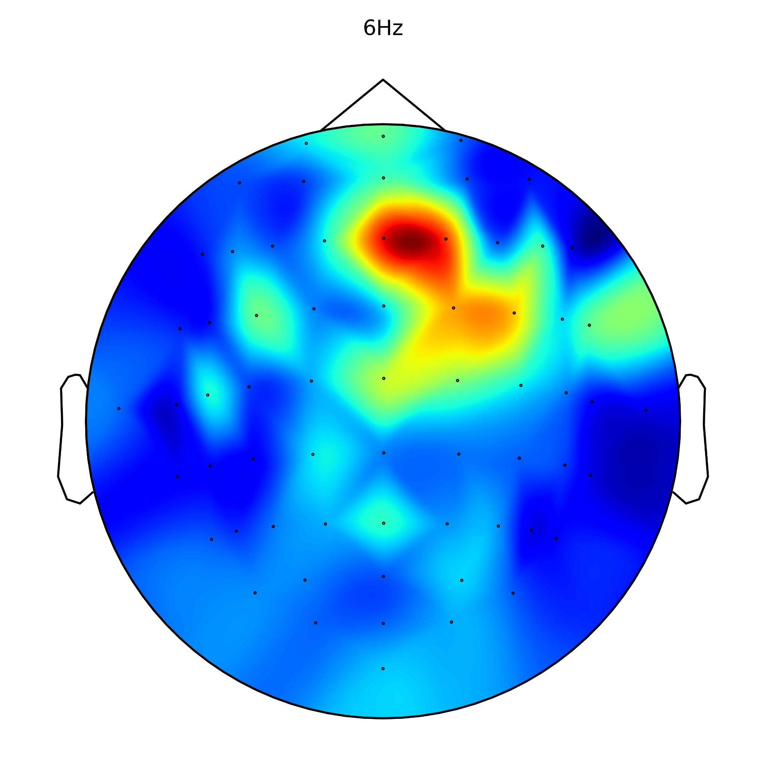
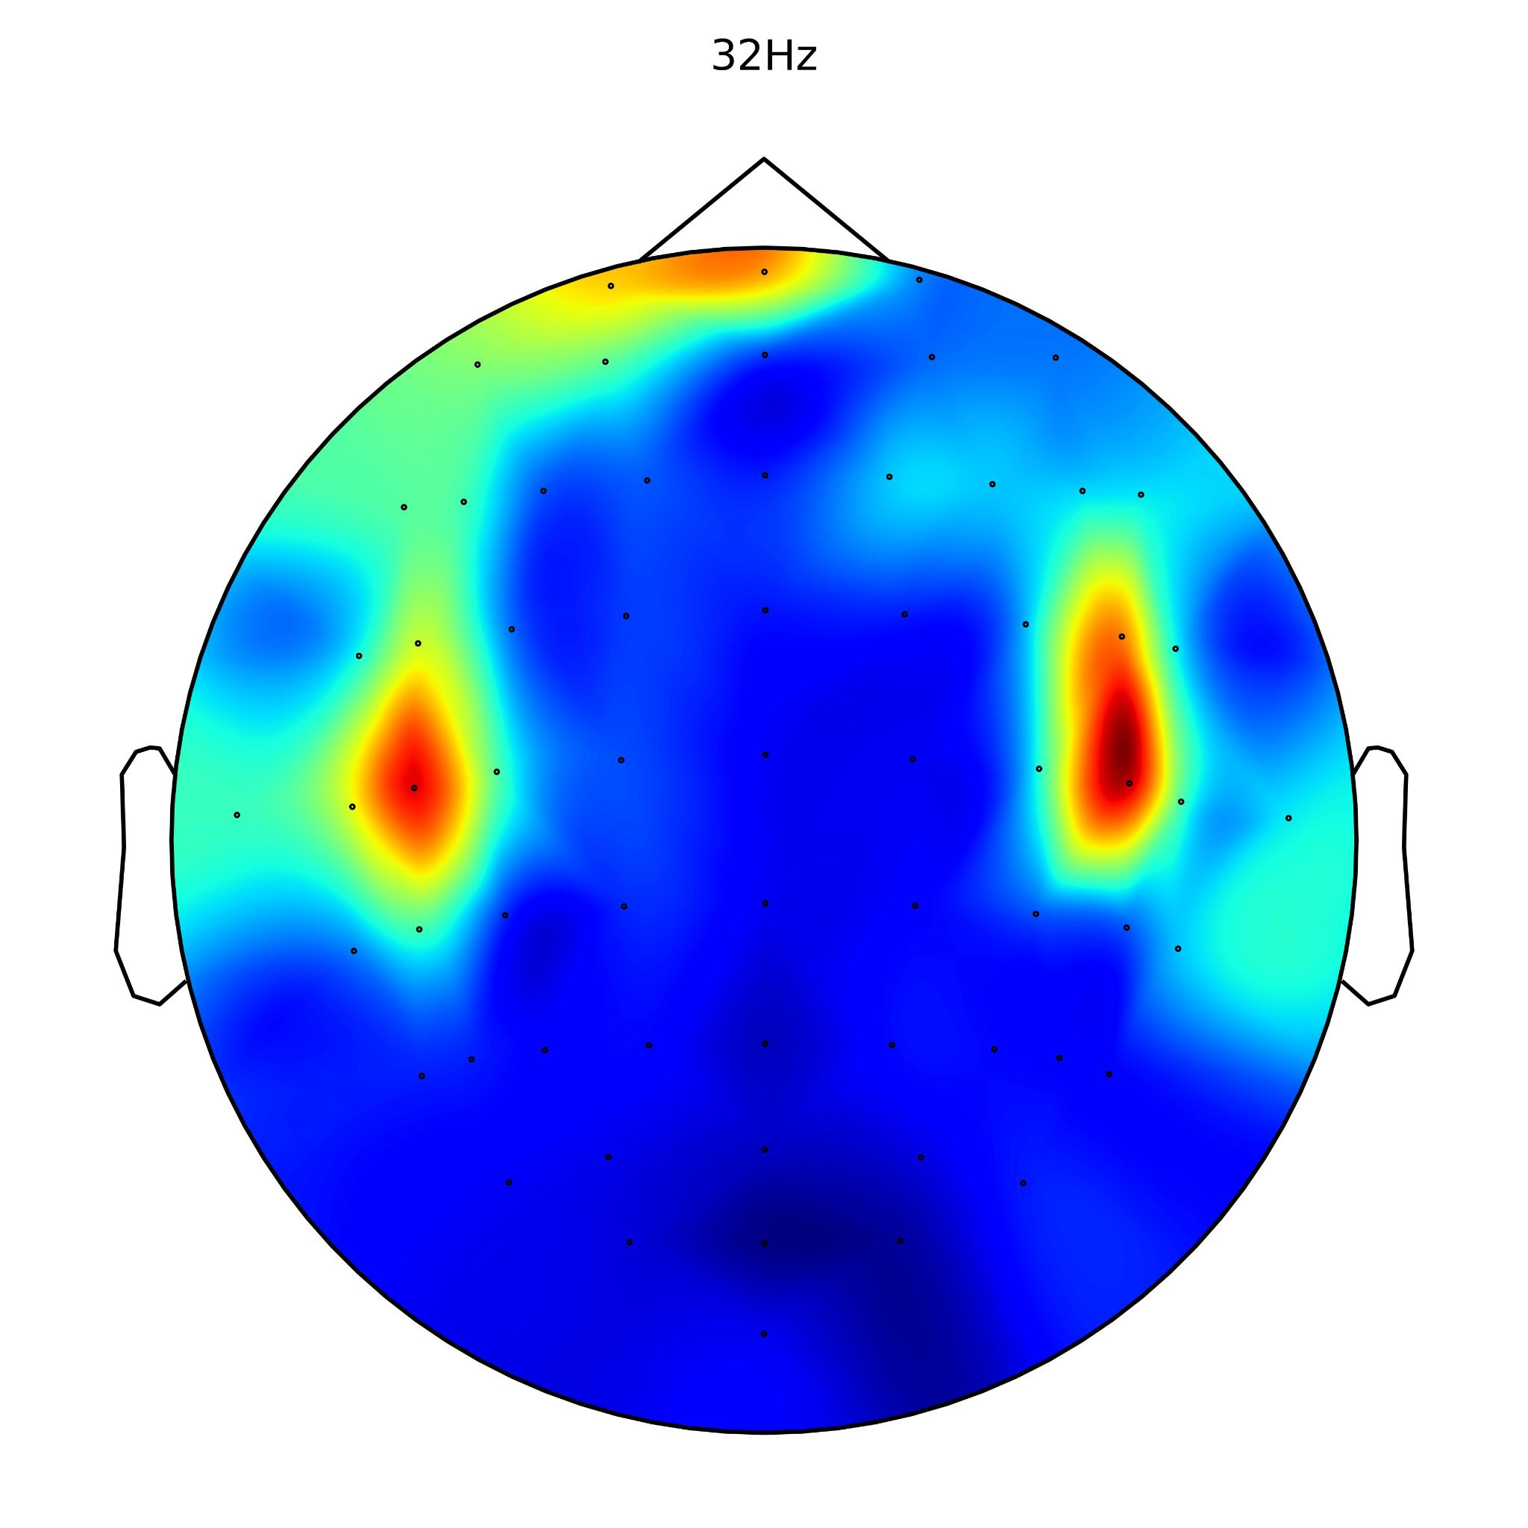
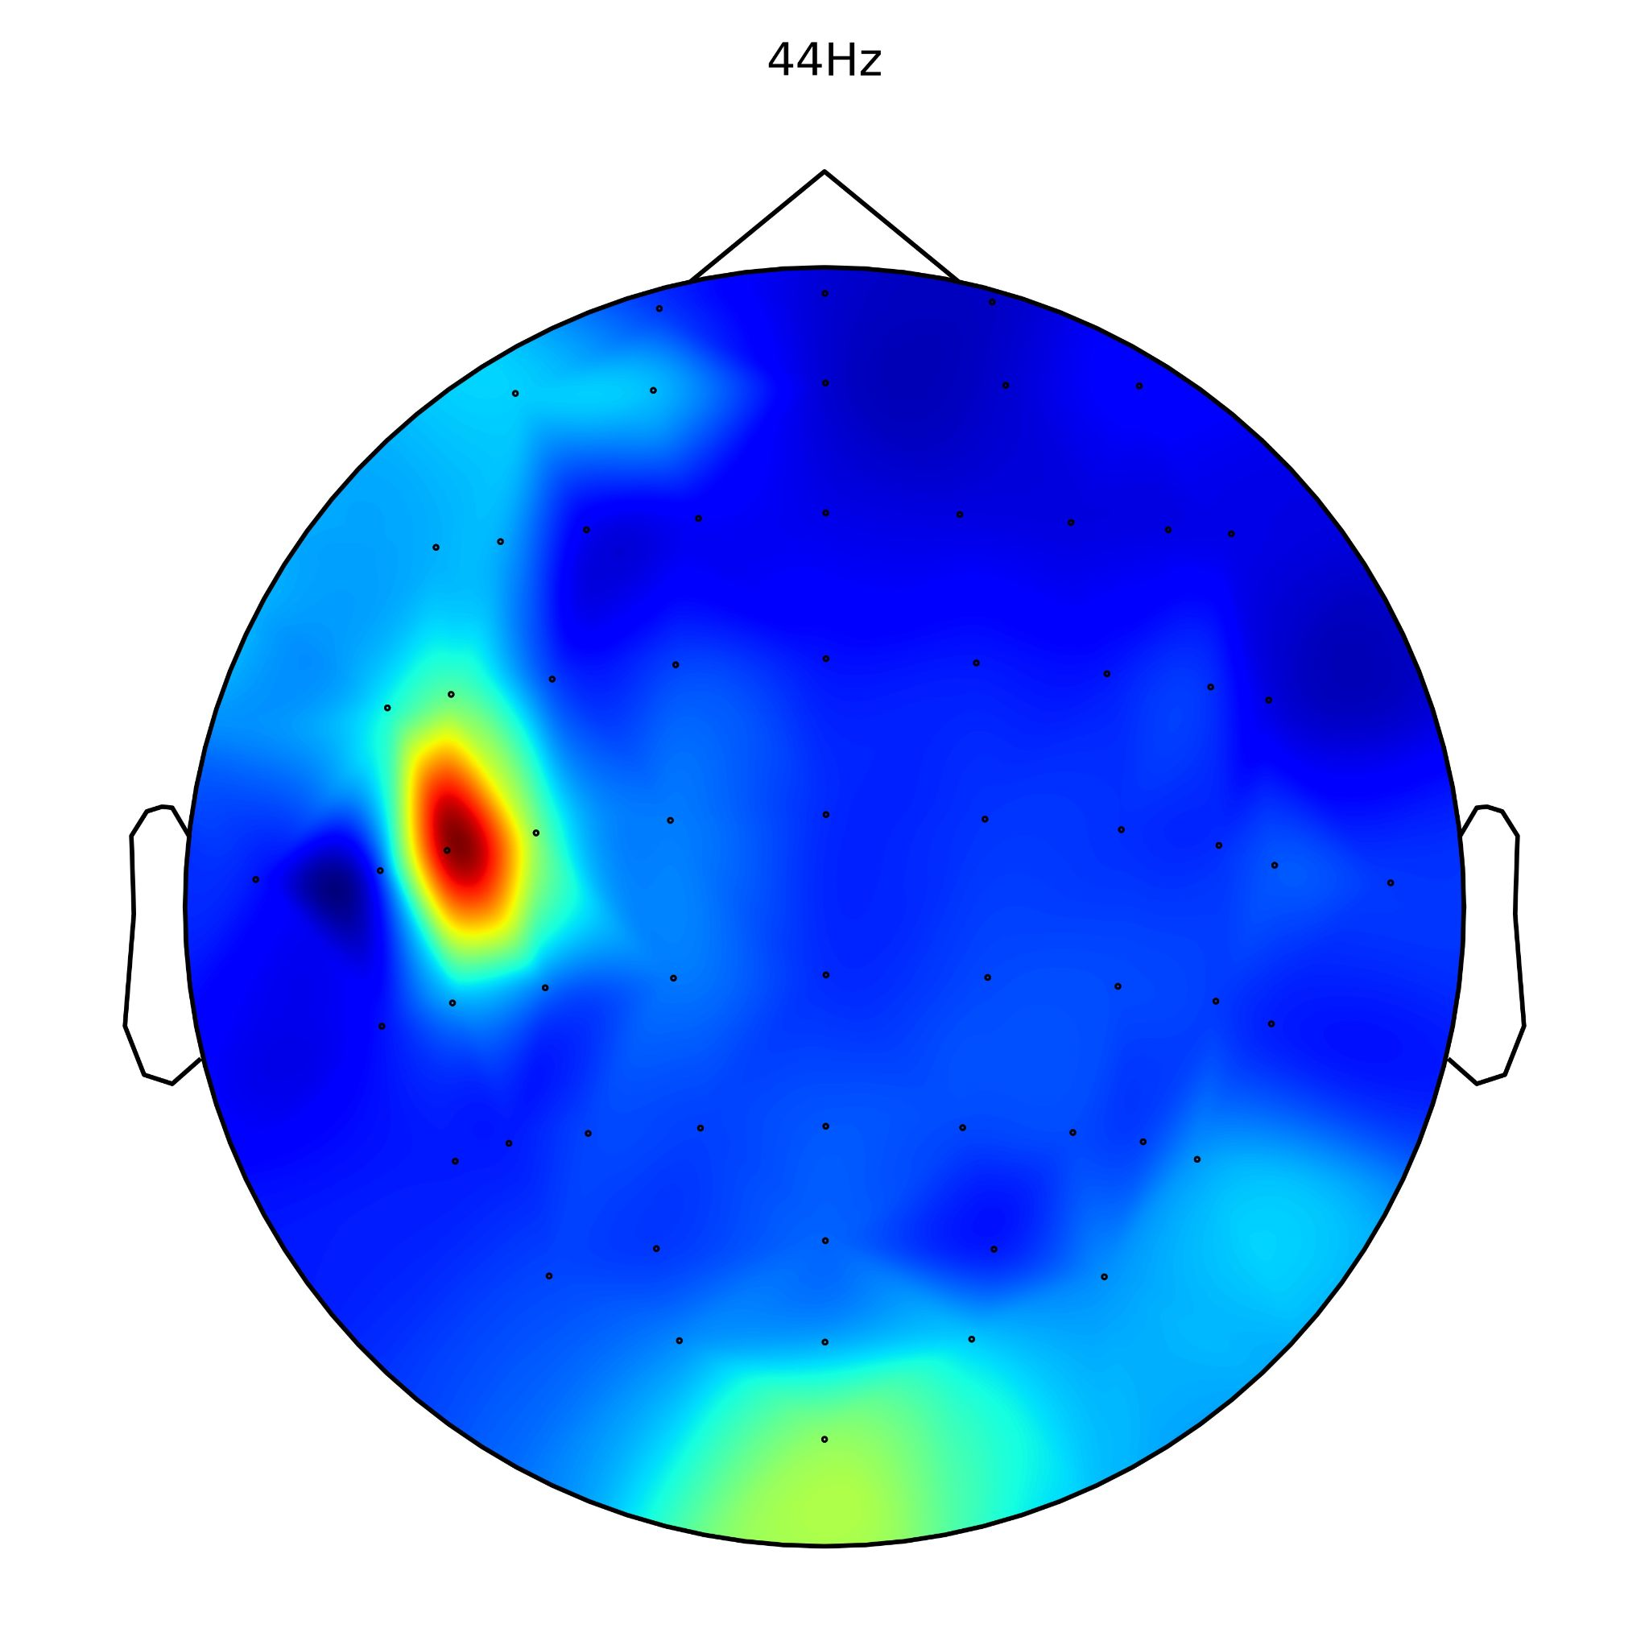
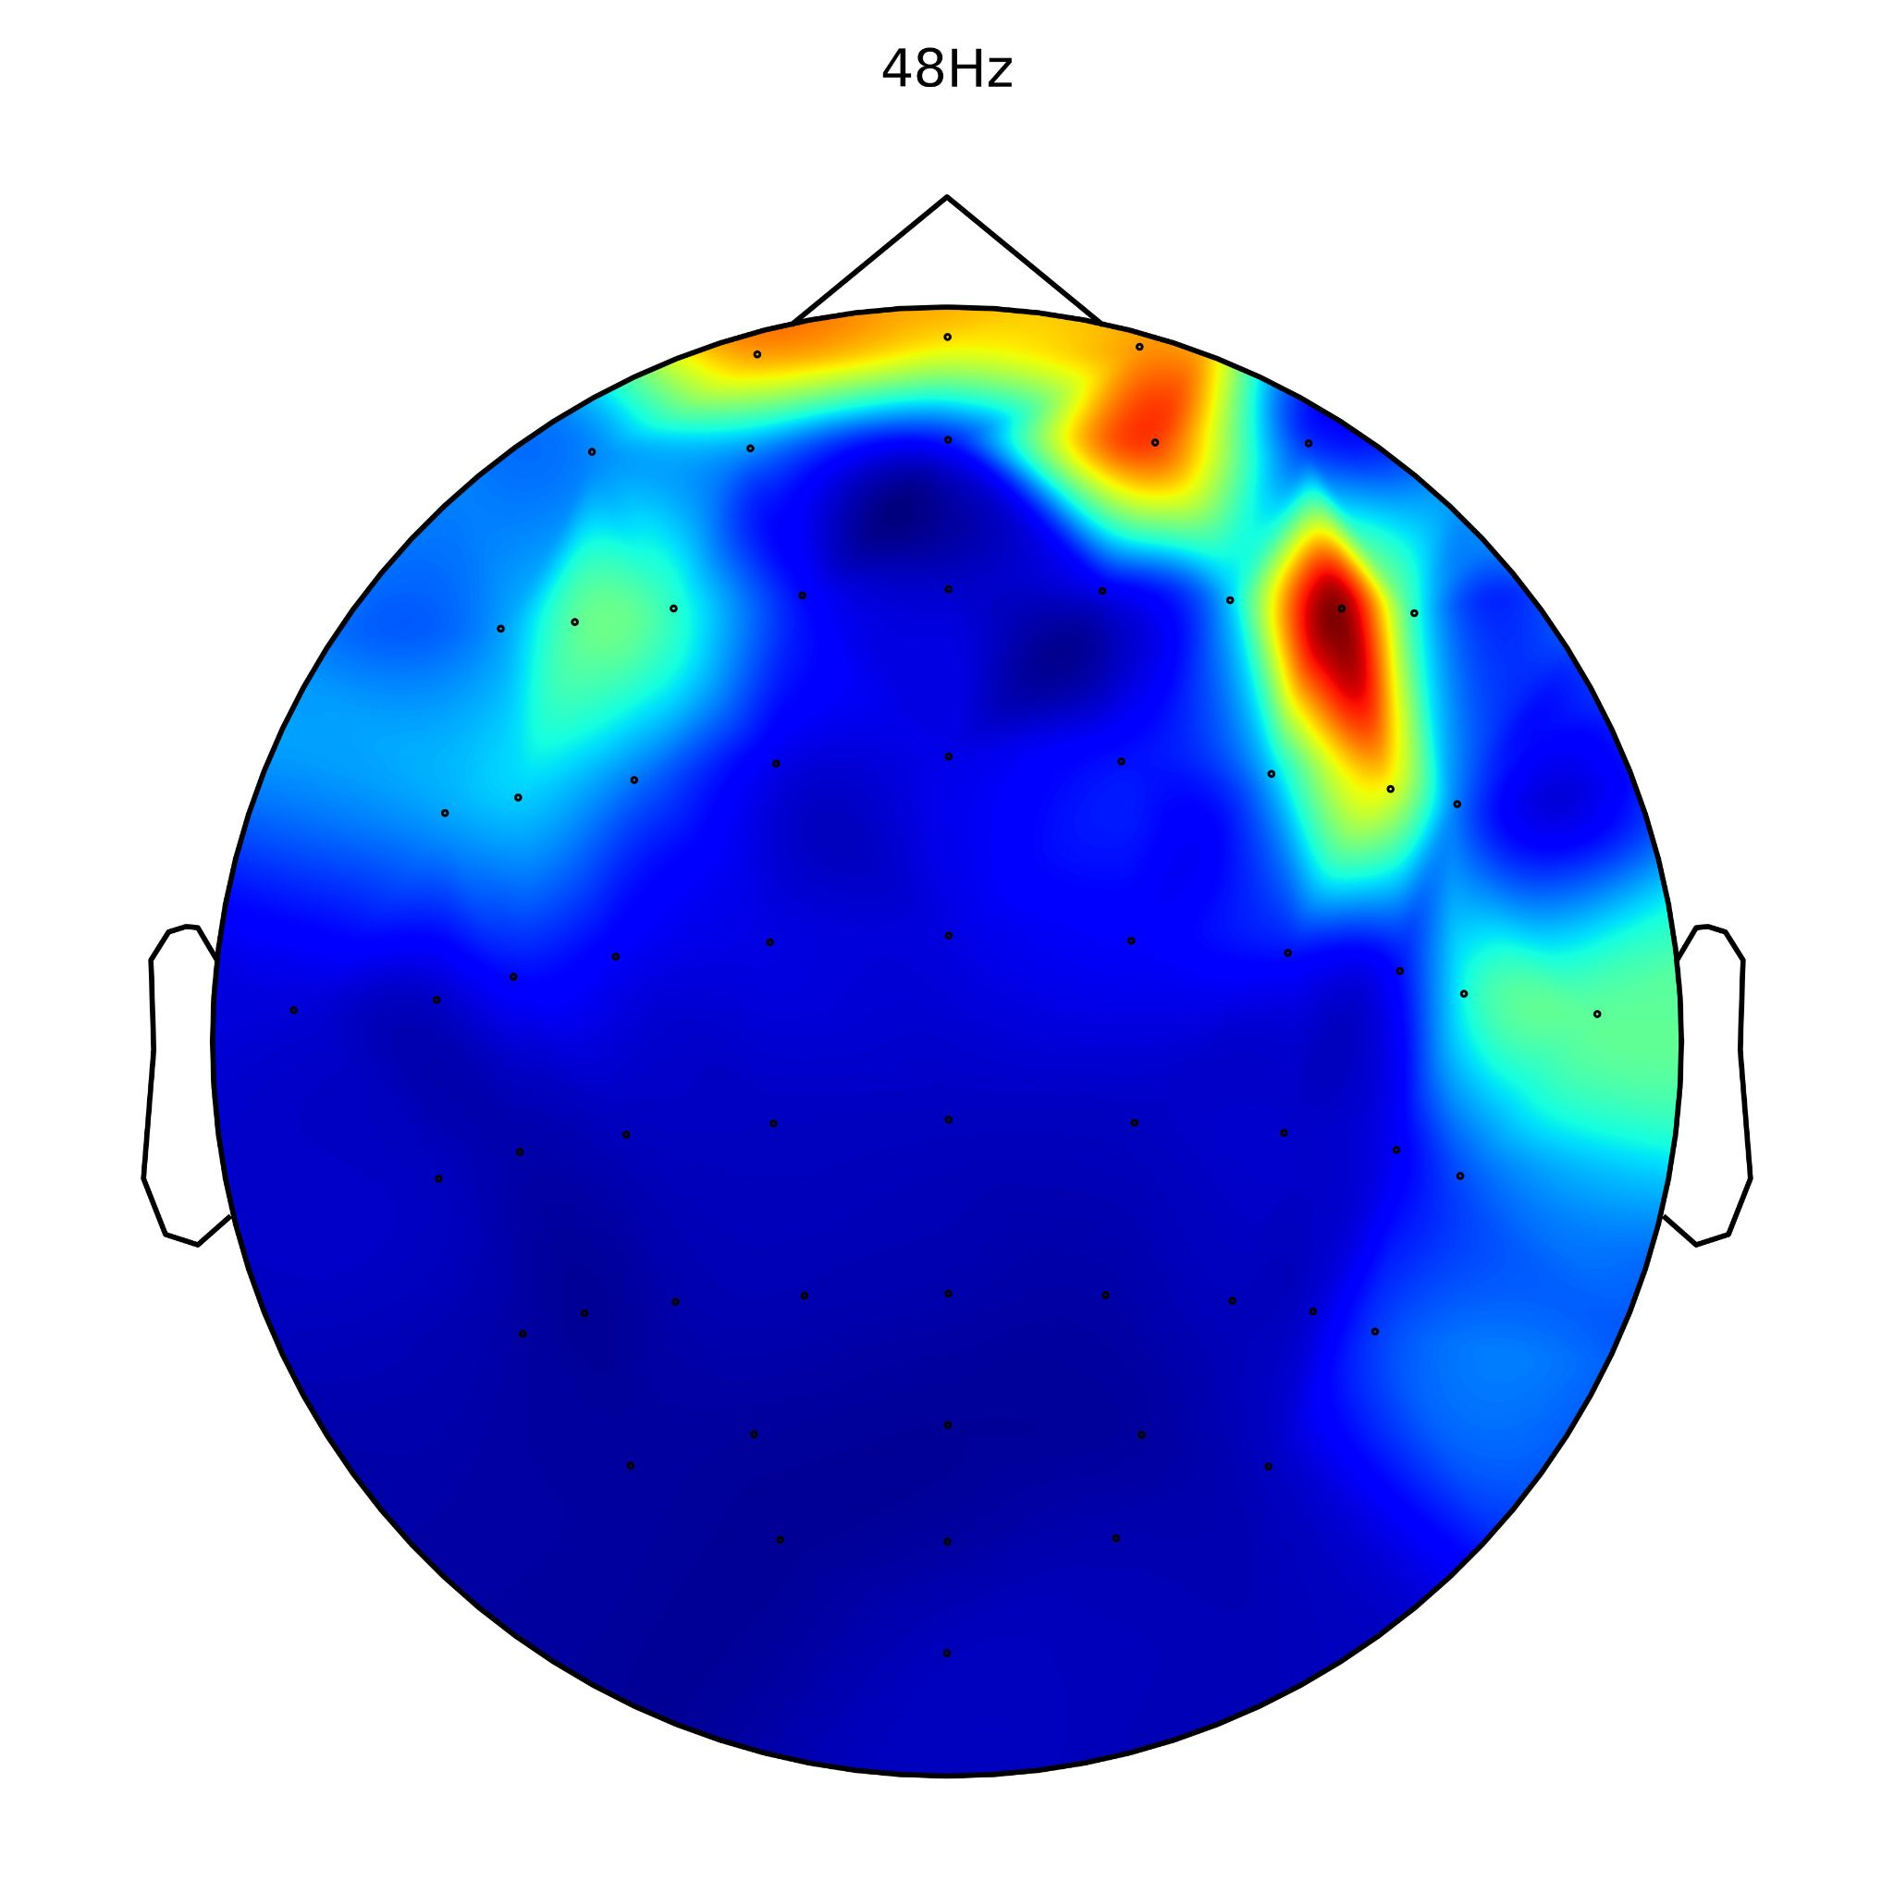
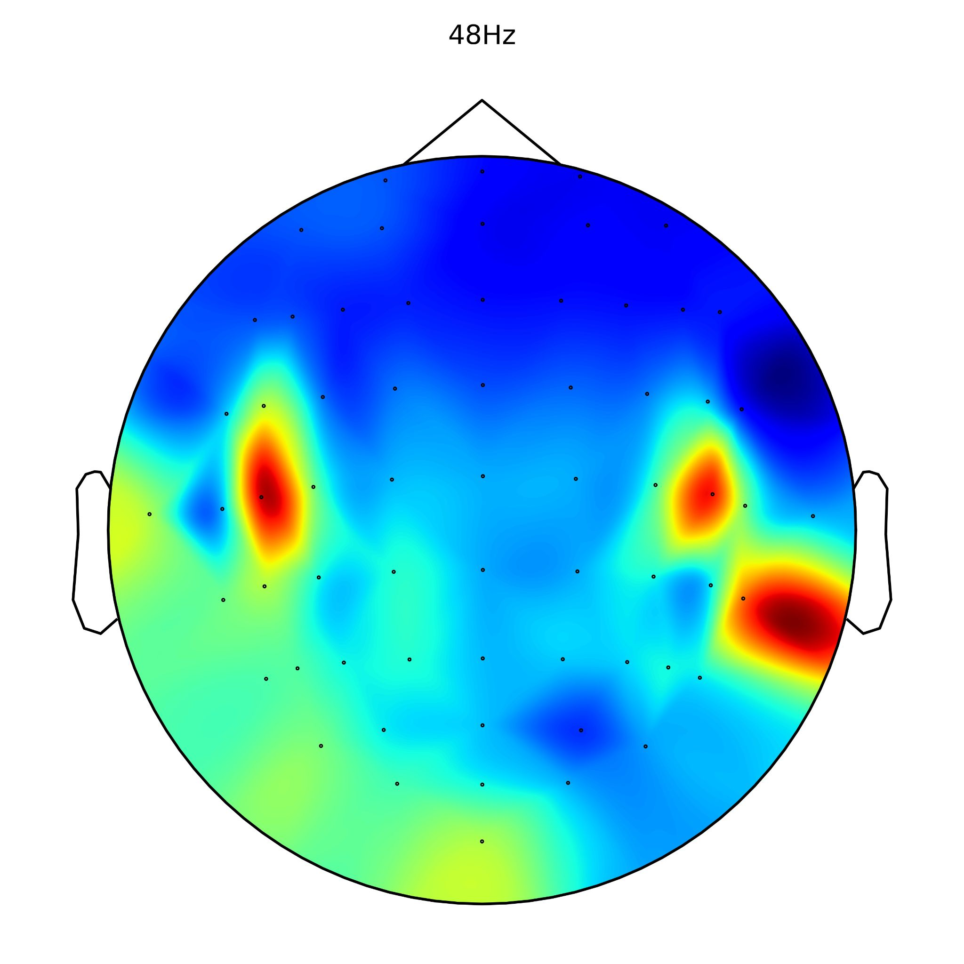
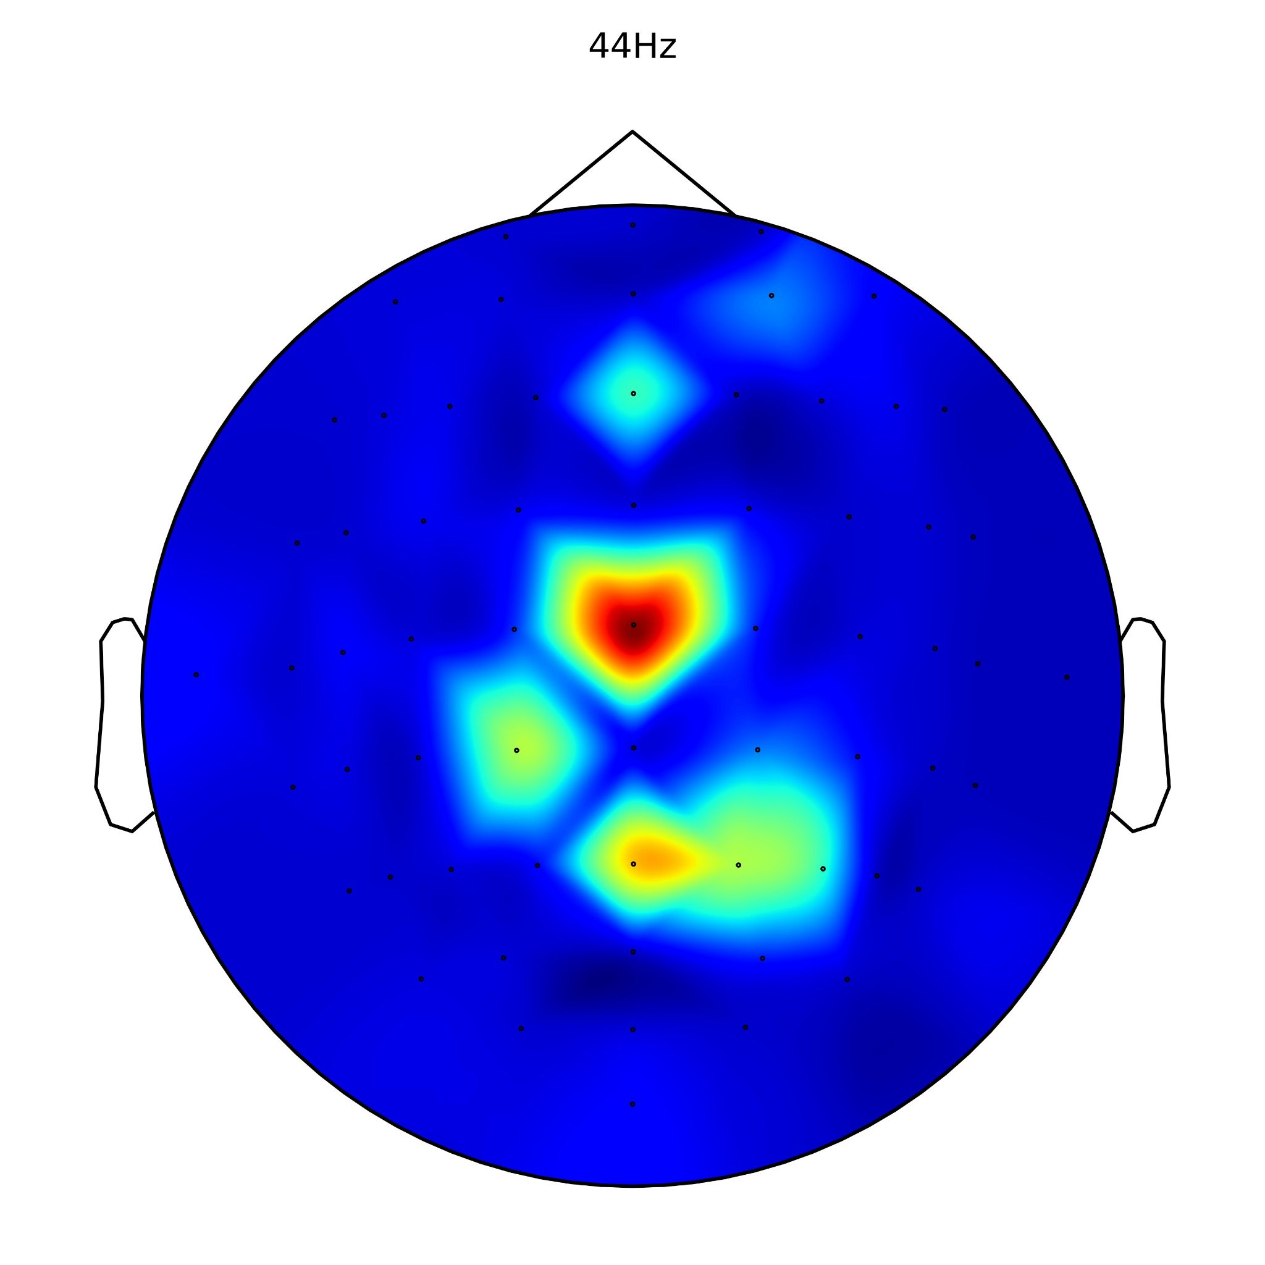
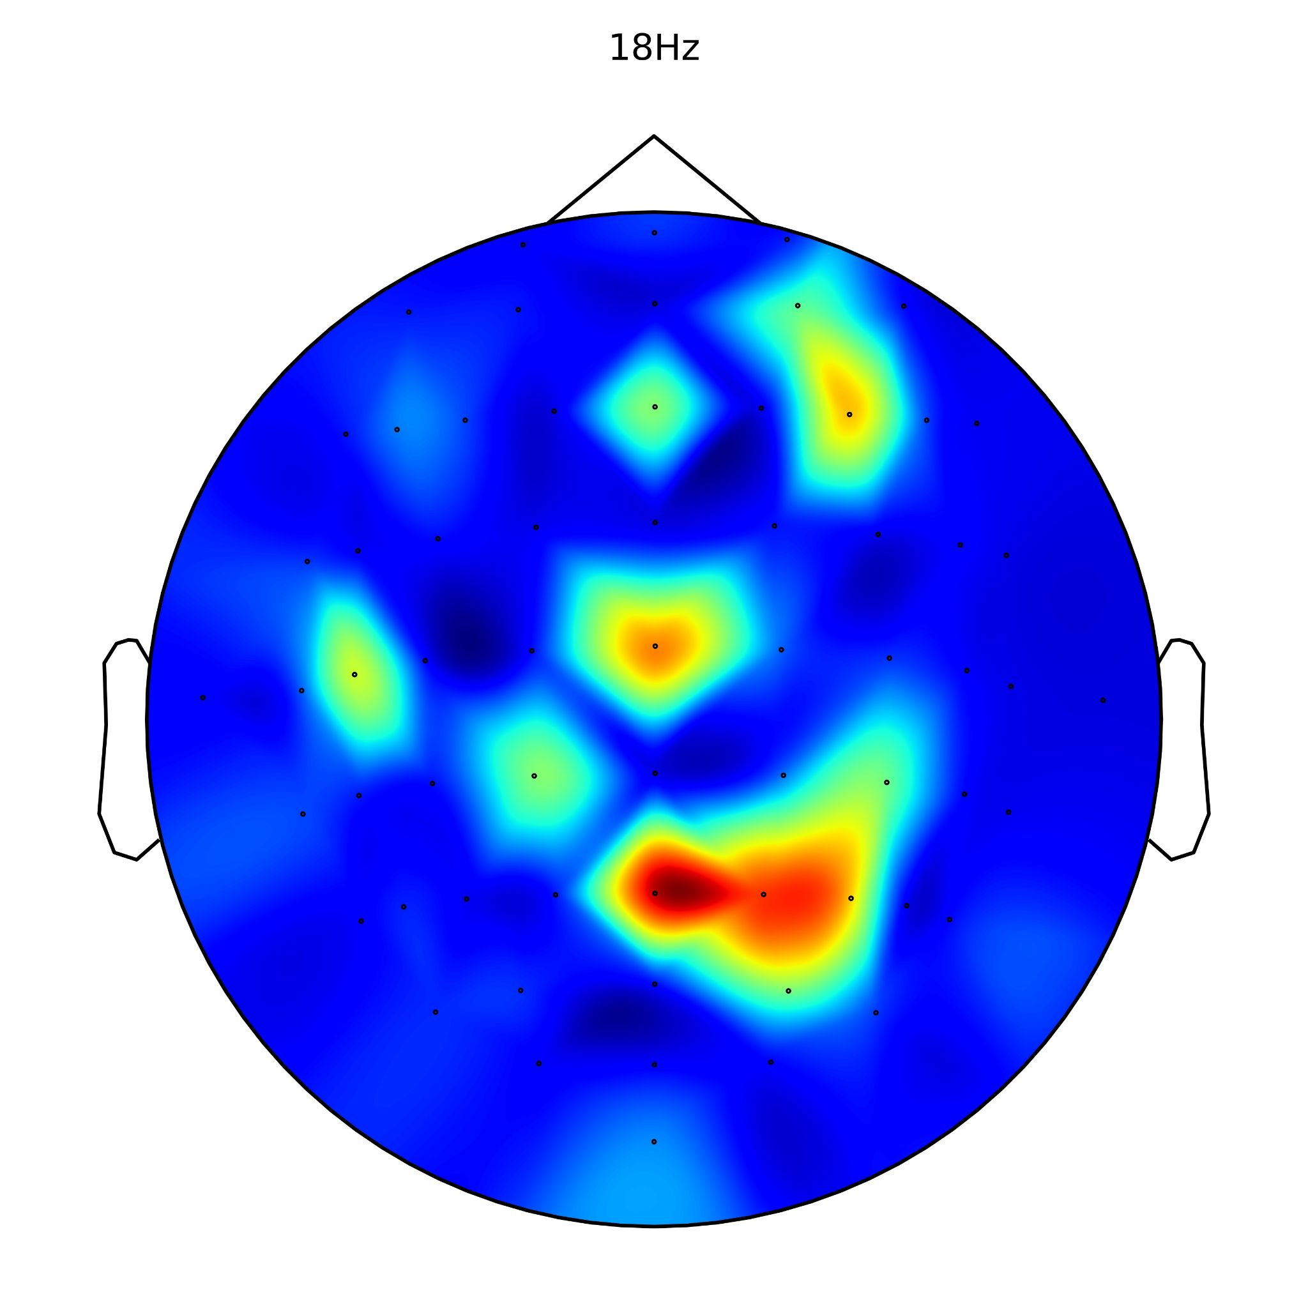
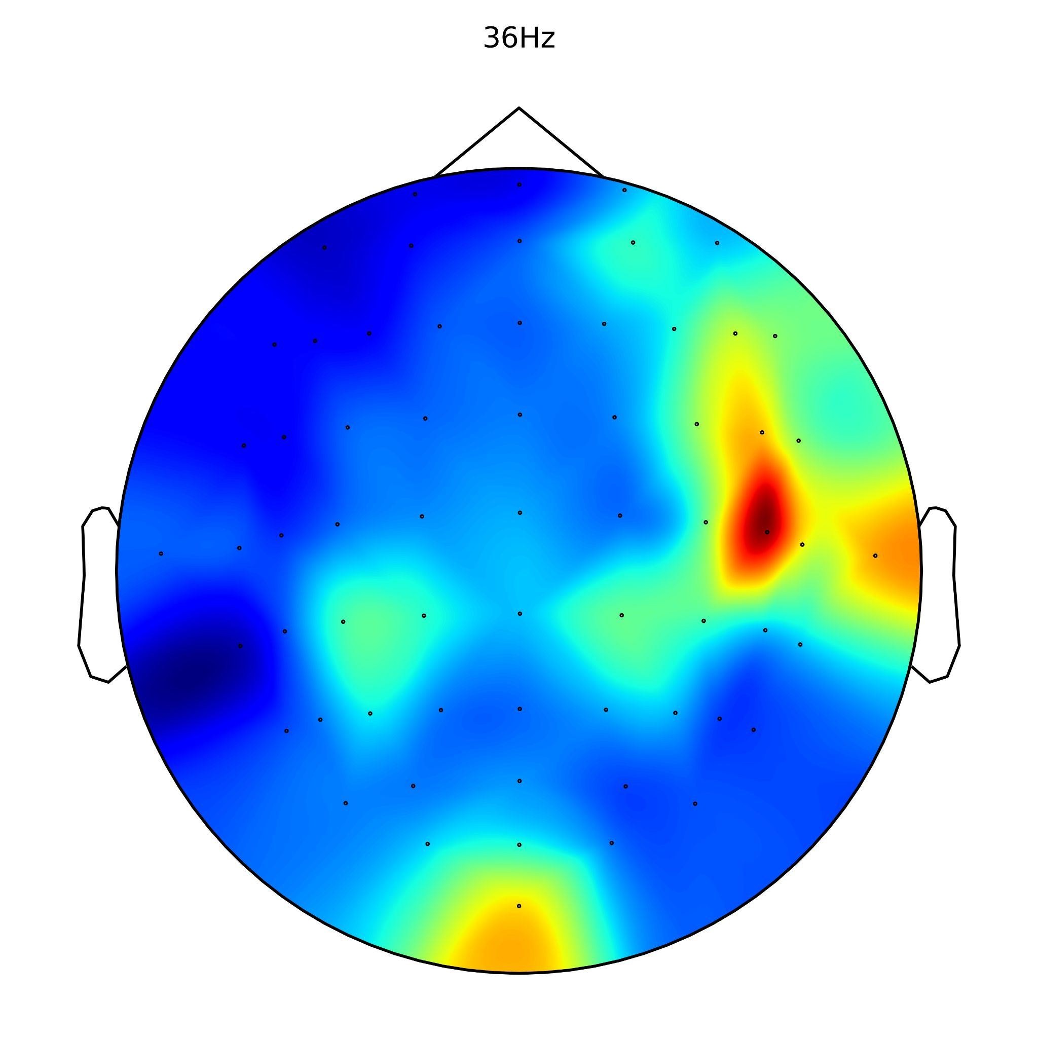
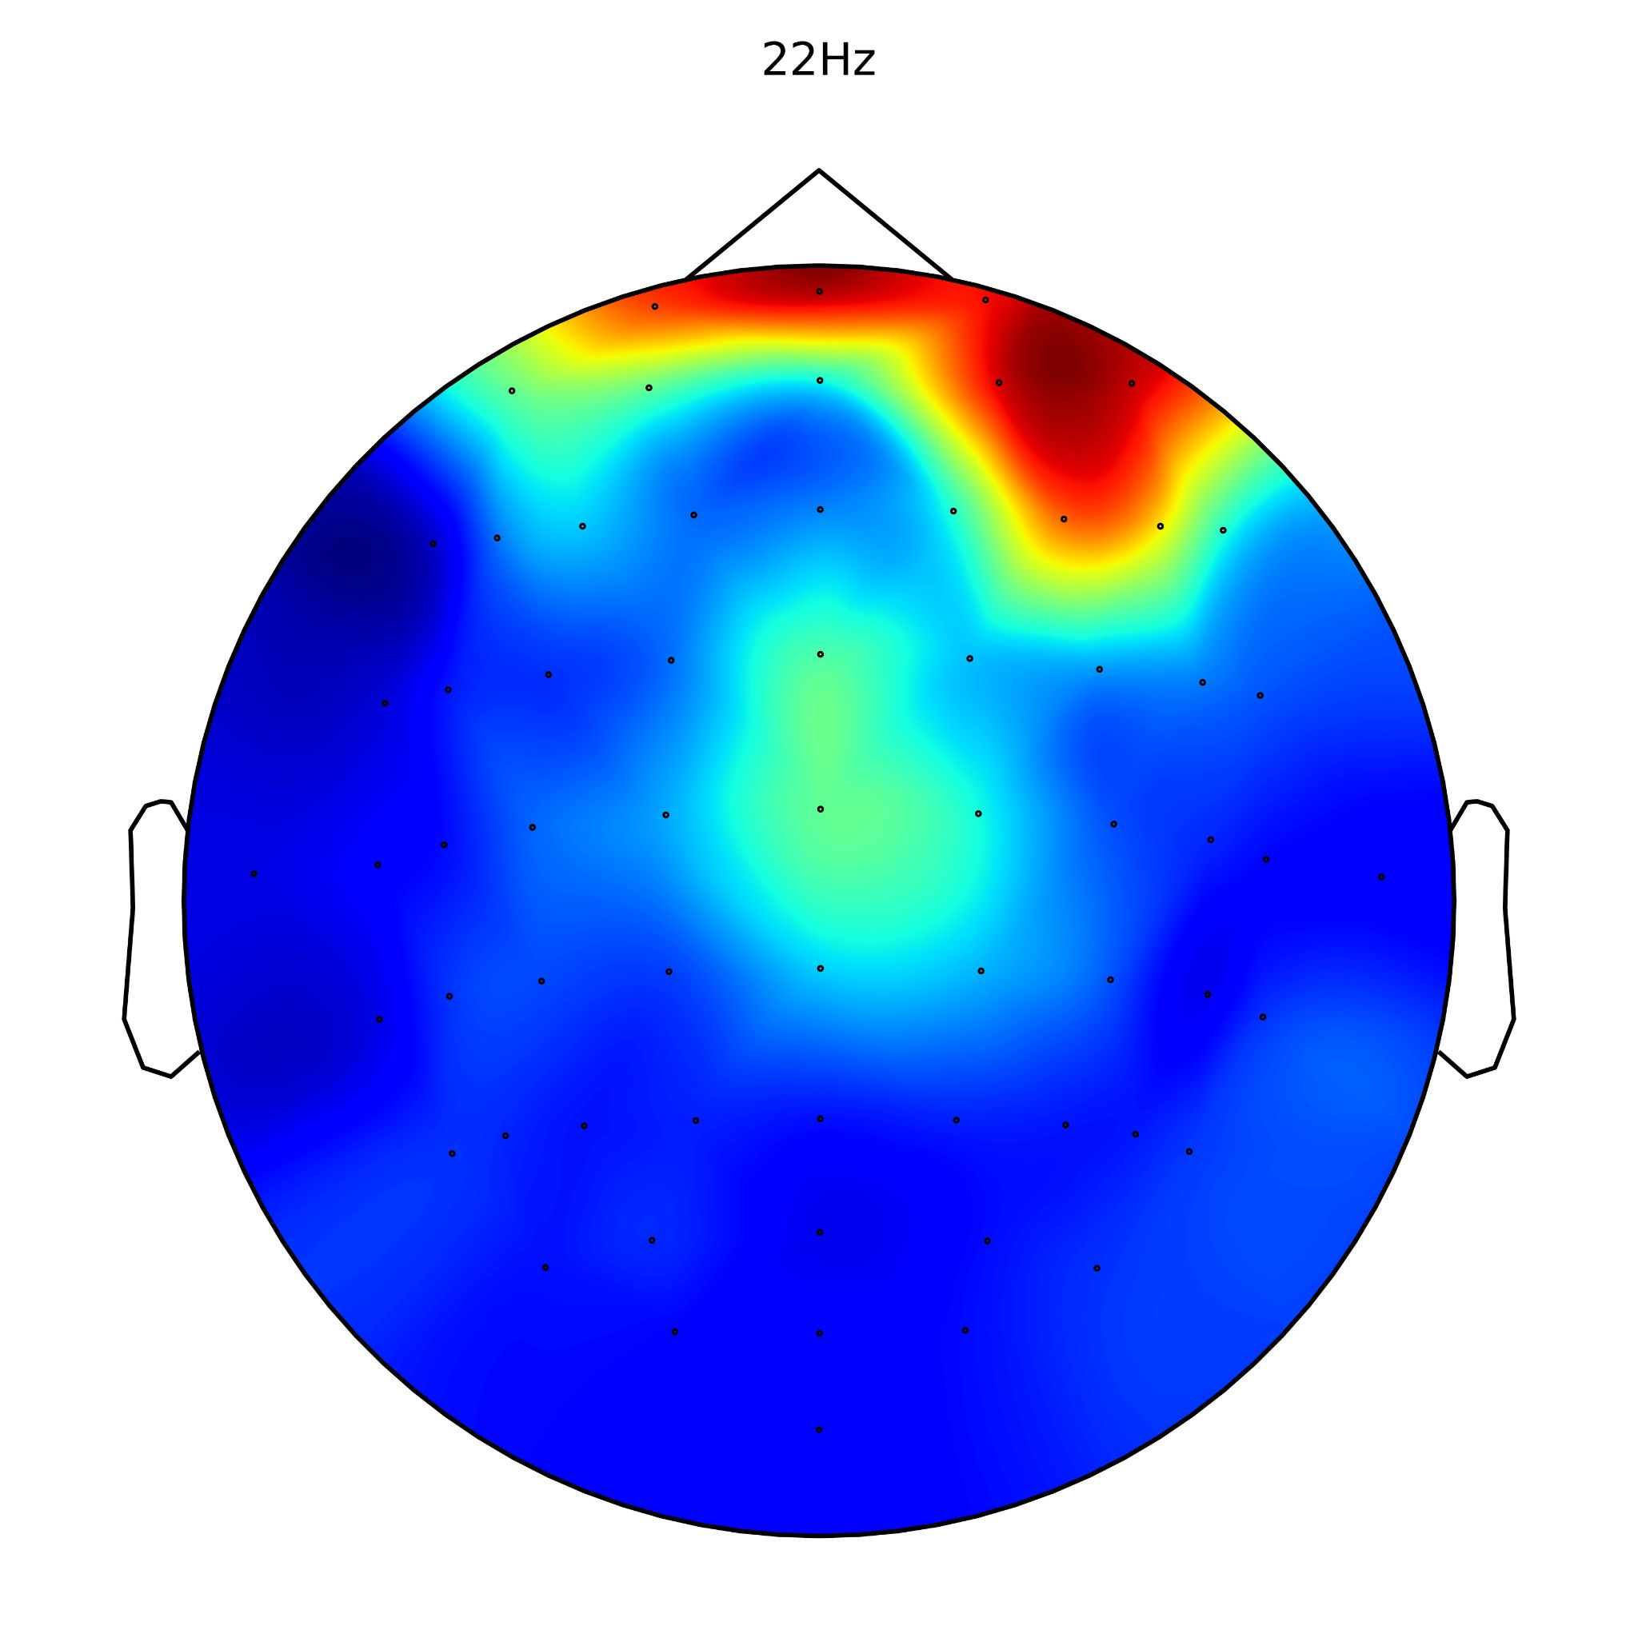
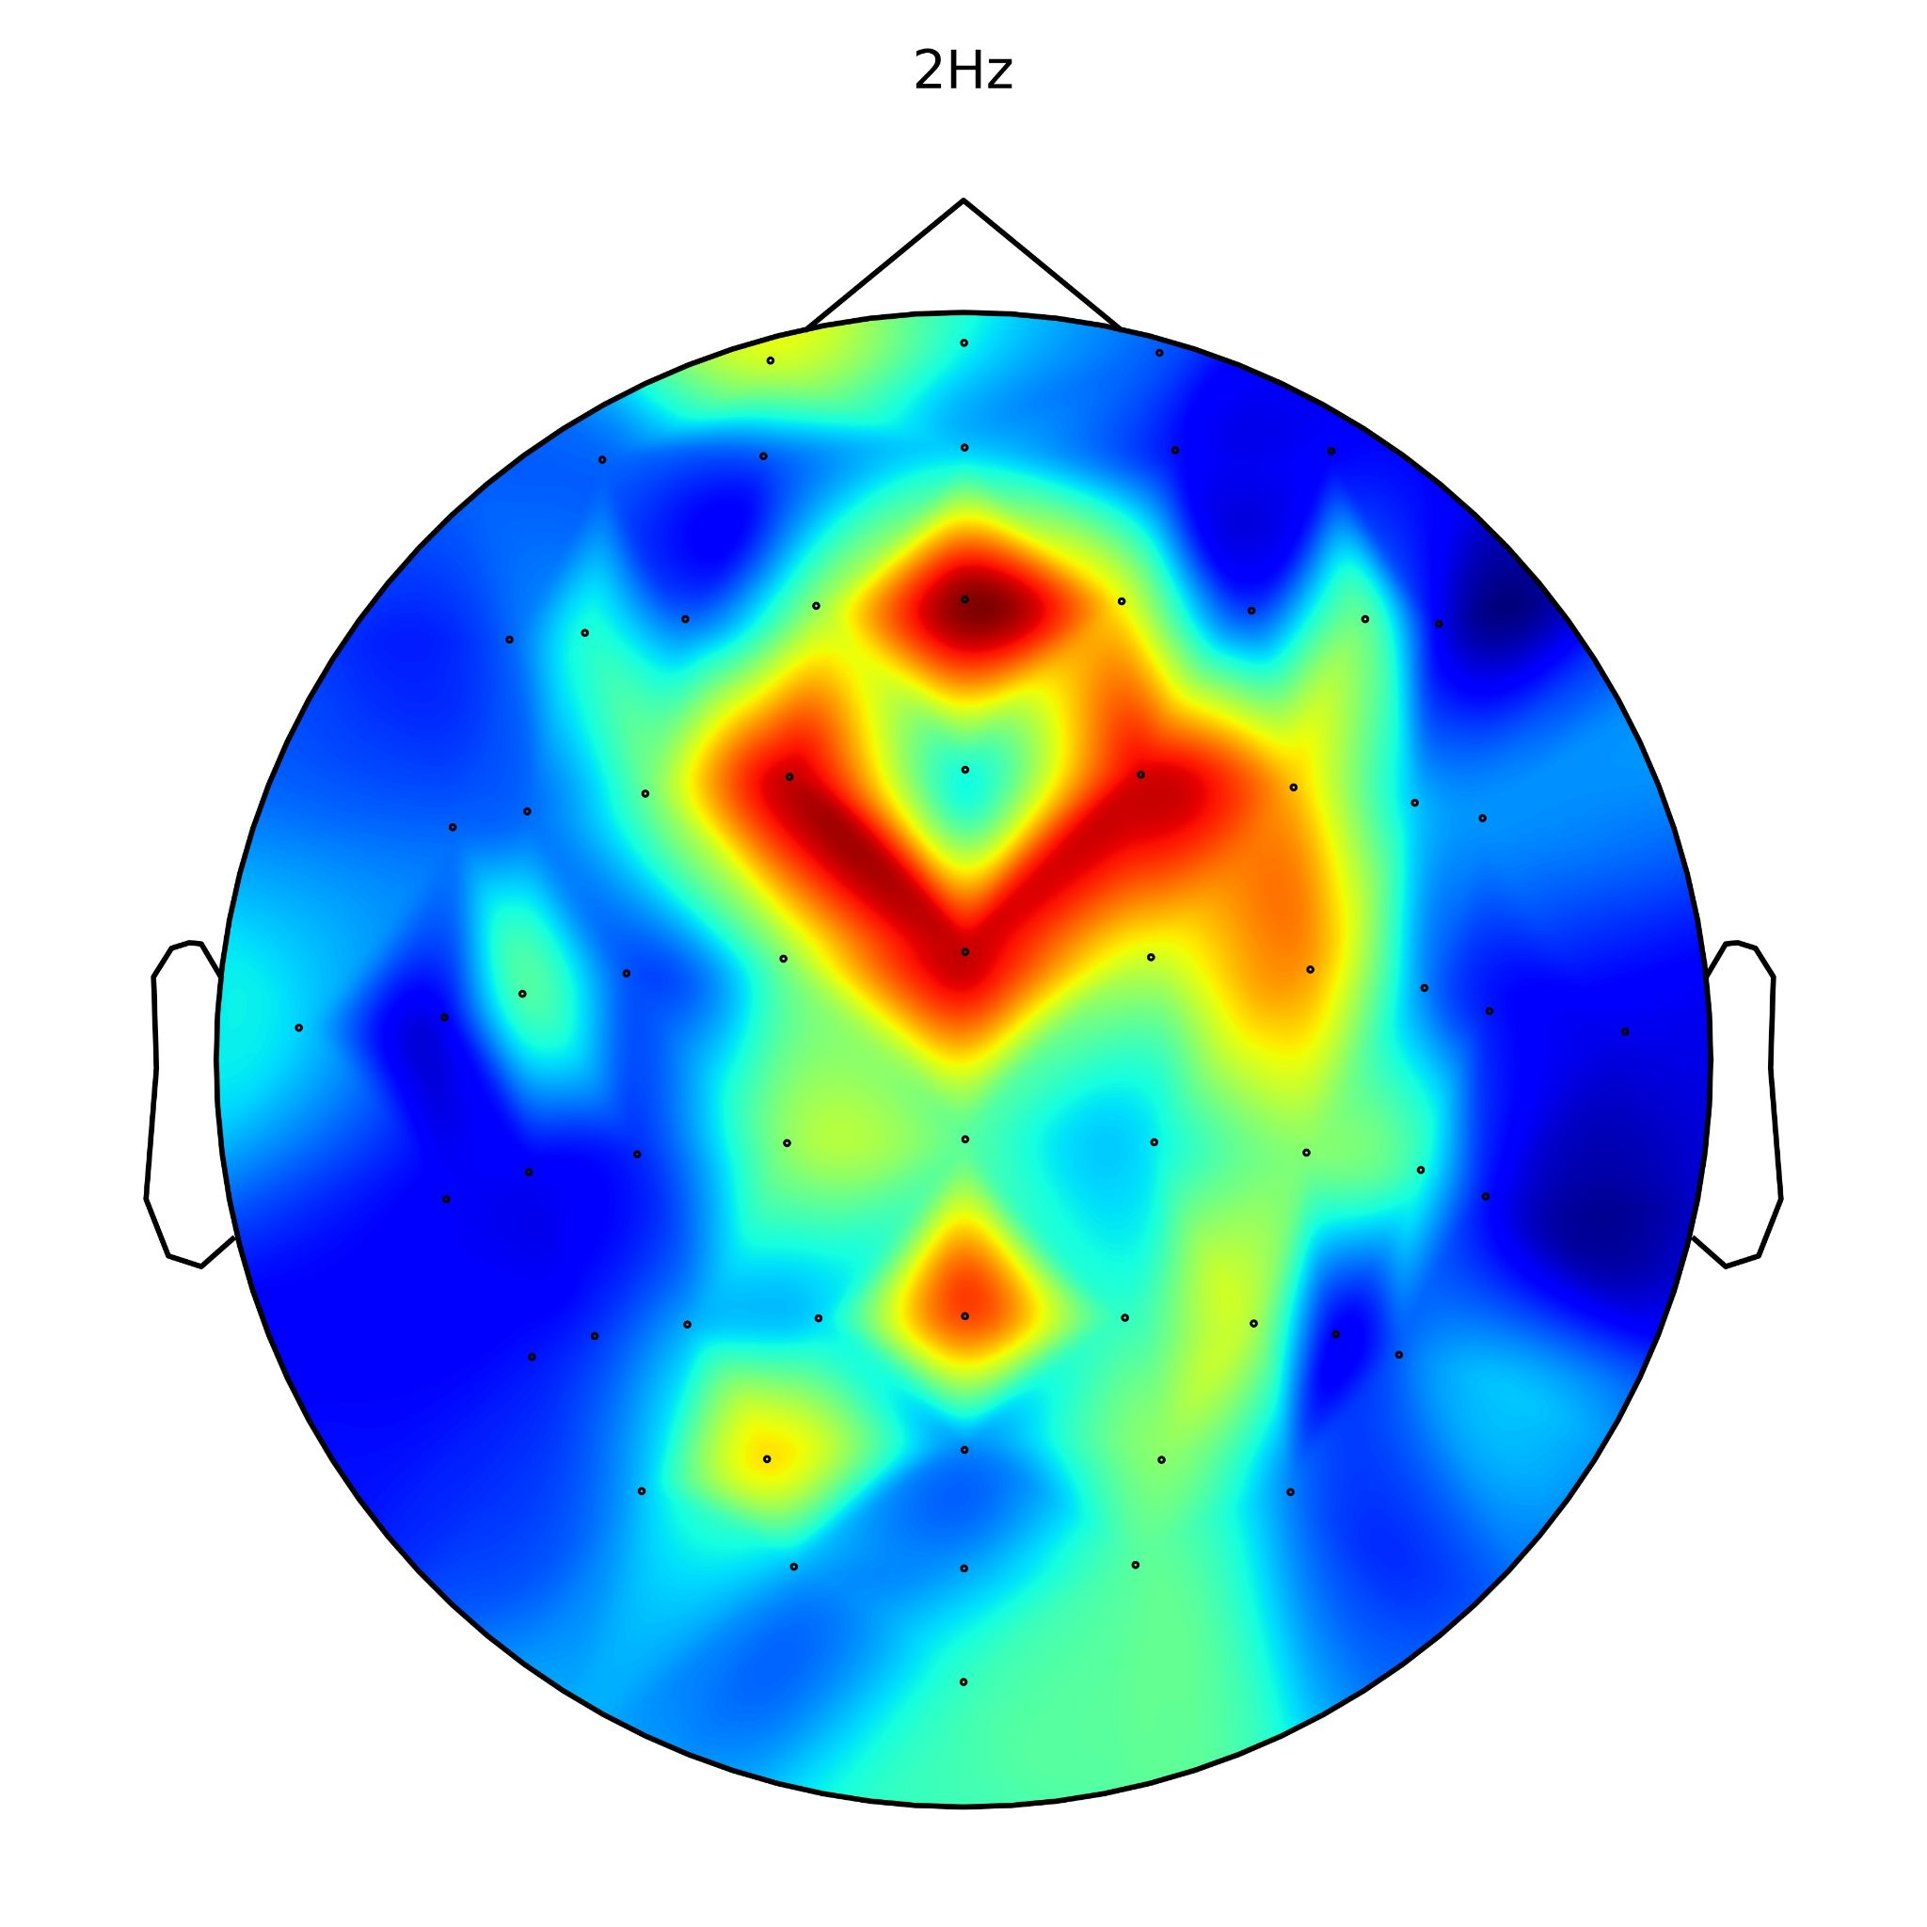
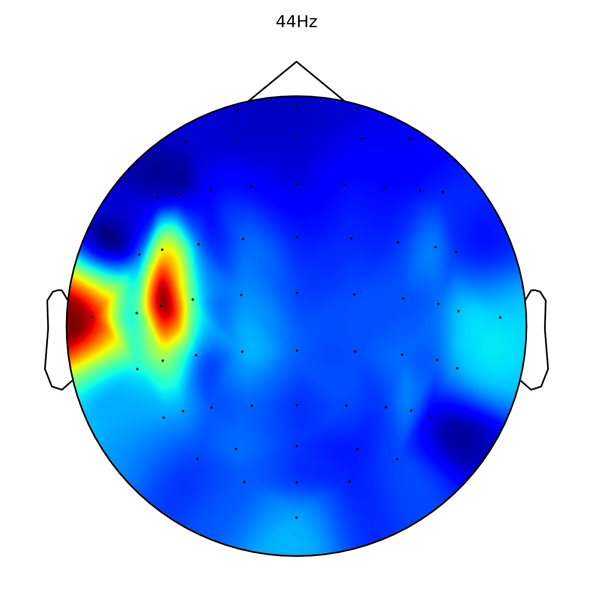
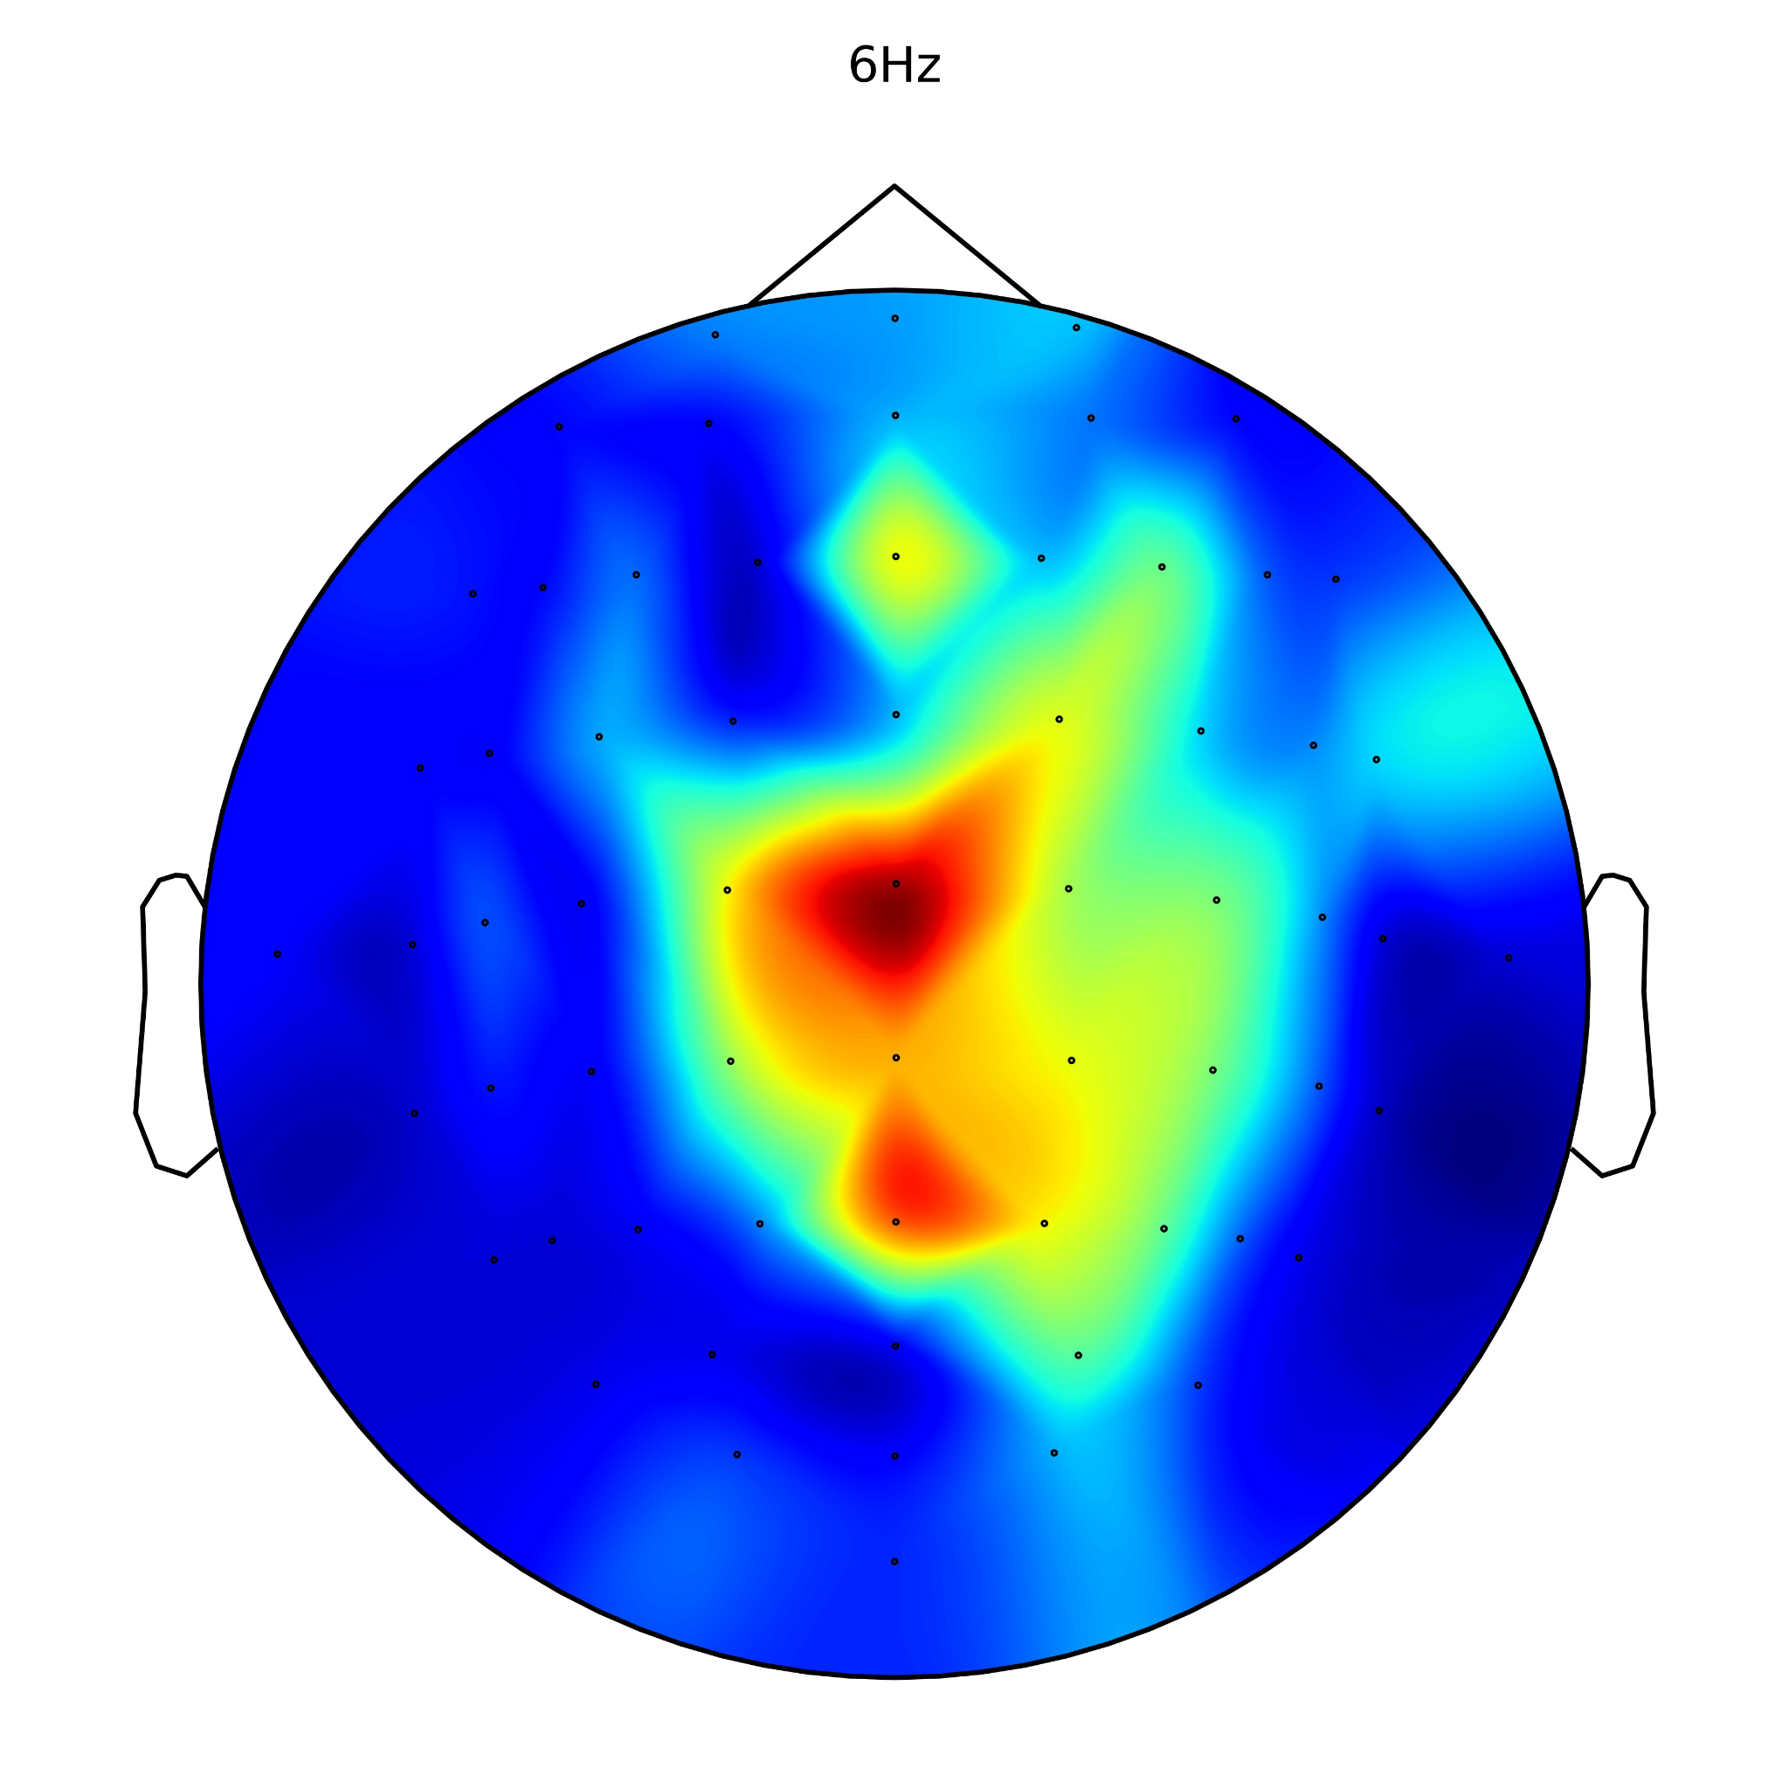
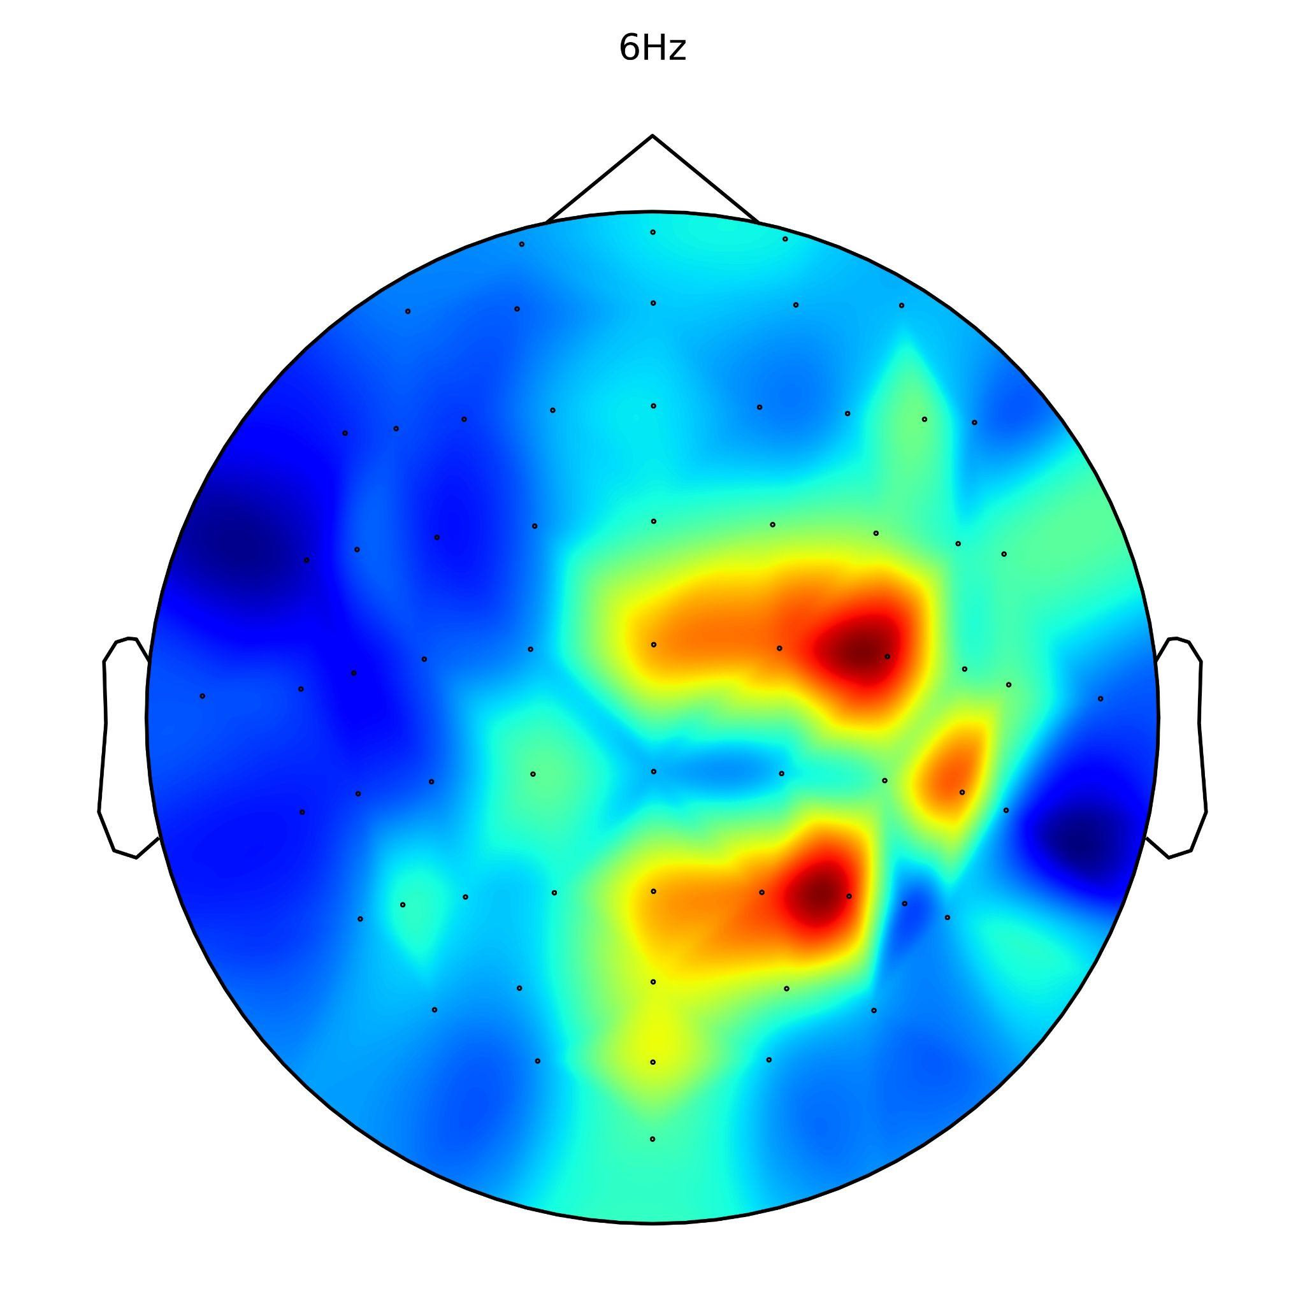









Spectral-Stream
Temporal-Stream
Temporal-Stream

Slide 41
Spectral-Stream
Temporal-Stream

Slide 42

C3
C4
1
Cz
0
Kernel #3
Kernel #7
Kernel #8
Kernel #15
Kernel #23
Kernel #35
Kernel #46
Kernel #63
(a) Spectral-Stream
0
Fz
1
CPz
Pz
0
Cz
Kernel #5
Kernel #13
Kernel #25
Kernel #35
Kernel #47
Kernel #51
Kernel #53
Kernel #64
(b) Temporal-Stream

Slide 43
C3
C4
1
Cz
0
Kernel #3
Kernel #7
Kernel #8
Kernel #15
Kernel #23
Kernel #35
Kernel #46
Kernel #63
(a) Spectral-Stream
Fz
0
1
CPz
Pz
Cz
0
Kernel #5
Kernel #13
Kernel #25
Kernel #35
Kernel #47
Kernel #51
Kernel #53
Kernel #64
(b) Temporal-Stream

Slide 44

C4
C3
C4
Cz

Slide 45




Subject #3
Subject #10
Subject #12

Slide 46
Subject #3
Subject #10
Subject #12

Slide 47







Temporal/Frequency Steps
(a)
Time (s)
(b)
Frequency (Hz)
(c)
(a)
(b)
(c)
Test Sample #3
Temporal/Frequency Steps
(a)
Temporal/Frequency Steps
(a)
(a)
(b)
Time (s)
(b)
(c)
Frequency (Hz)
(c)
Test Sample #7

Slide 49
EEG (64 channels)
Temporal-Stream
L
L
A
200
C
Bicubic
100
μV
0
C
L
L
A
1000ms
-100
C
60ms
-200
40ms
L
L
A
0
0.2
0.4
0.6
0.8
1.0
20ms
C
Time (s)
Amplitude of all channels in time domain
(0-1s, downsampling to 100Hz)
Temporal Topographic Maps
(50 frames)
L
L
A
Spectral-Stream
EEG (64 channels)
L
L
A
50
C
45
Bicubic
40
C
μV²/Hz (dB)
L
L
A
Softmax
Layer
35
50Hz
30
C
3Hz
L
L
A
25
2Hz
C
(c) MI Classification
0
10
20
30
40
50
1Hz
Frequency (Hz)
L
L
A
PSD of all channels in frequency domain
(0-50Hz, average of 0-4s (one trial))
Spectral Topographic Maps
(50 frames)
CNN
RNN
ANN
(a) EEG Topographic Map Generation
(b) DSNN for Spatial-Spectral-Temporal Representation Learning

Slide 50
Temporal-Stream
45
0.06
Spectral-Stream
250
40
0.05
200
35
0.04
150
30
Attention Value
μV²/Hz (dB)
0.03
μV
100
25
0.02
20
0.01
50
15
0.00
10
20
30
40
2
10
20
30
40
50
0
0.2
0.4
0.6
0.8
1.0
0
50
(b)
(c)
Temporal/Frequency Steps
(a)
Time (s)
(b)
Frequency (Hz)
(c)
Test Sample #3
0.06
Temporal-Stream
100
Spectral-Stream
45
0.05
80
40
0.04
35
60
Attention Value
30
0.03
μV
μV²/Hz (dB)
40
25
0.02
20
0.01
20
15
0.00
10
2
10
20
30
40
50
0
0.2
0.4
0.6
0.8
1.0
0
10
20
30
40
50
Temporal/Frequency Steps
(a)
(b)
Time (s)
(b)
Frequency (Hz)
(c)
Test Sample #7

Slide 51
Temporal-Stream
45
0.06
Spectral-Stream
250
40
0.05
200
35
0.04
150
30
Attention Value
μV²/Hz (dB)
0.03
μV
100
25
0.02
20
0.01
50
15
0.00
10
20
30
40
2
10
20
30
40
50
0
0.2
0.4
0.6
0.8
1.0
0
50
(b)
(c)
Temporal/Frequency Steps
(a)
Time (s)
(b)
Frequency (Hz)
(c)
Test Sample #3
0.06
Temporal-Stream
100
Spectral-Stream
45
0.05
80
40
0.04
35
60
Attention Value
30
0.03
μV
μV²/Hz (dB)
40
25
0.02
20
0.01
20
15
0.00
10
2
10
20
30
40
50
0
0.2
0.4
0.6
0.8
1.0
0
10
20
30
40
50
Temporal/Frequency Steps
(a)
(b)
Time (s)
(b)
Frequency (Hz)
(c)
Test Sample #7

Slide 52
Temporal-Stream
Spectral-Stream
Temporal-Stream
Spectral-Stream

Slide 53
1
1
0
Spectral Power
0.5
0
No
Low
High
Intolerable
No
Low
High
Intolerable
Kernel #35
Kernel #48

Slide 54
1
1
0
Spectral Power
0.5
0
No
Low
High
Intolerable
No
Low
High
Intolerable
Kernel #35
Kernel #48

Slide 55
1
0
1
Spectral Power
0.5
0
No
Low
High
Intolerable
Kernel #35

Slide 56
1
Kernel #35
0
1
Kernel #48
0
1
Kernel #61
Kernel #61
0
No
Low
High
Intolerable

Slide 57
1
Kernel #35
0
1
Kernel #48
0
1
Kernel #61
Kernel #61
1
0
1
0
1
0
No
Low
High
Intolerable

Slide 58

Confusion Matrix
No
Low
True Class
High
Intolerable
No
Low
High
Intolerable
Predicted Class

Slide 59

Confusion Matrix
No
Low
True Class
High
Intolerable
No
Low
High
Intolerable
Predicted Class

Slide 60
Confusion Matrix
No
Low
True Class
High
Intolerable
No
Low
High
Intolerable
Predicted Class

Slide 62


Slide 63
1
Spectral Power
0.5
0
No
Low
High
Intolerable
No
Low
High
Intolerable
Kernel #35
Kernel #48

Slide 65
Attention Matrix
ERP
Attention Matrix
PSD
1
0
25
Test sample #12
Attention Matrix
ERP
Attention Matrix
PSD
Test sample #27

Slide 66





Test sample #12
Test sample #27

Slide 67



(a) Temporal
Test sample #12
Test sample #27

Slide 68
Test sample #12

Slide 69
Test sample #27

Slide 70



(a)
(b)
(c)
Test Sample #3

Slide 71
(a)
(b)
(c)
Test Sample #3
(a)
(b)
(c)
Test Sample #7

Slide 72
(a)Test Sample #3
(b)Test Sample #7

Slide 74




Slide 76


Notes:
Note:
These visuals can represent a multi-directional array (3D) input, tensor, etc.
Author: Elvis Saravia (ellfae@gmail.com)

Slide 77


Notes:
Note:
These visuals can represent a multi-directional array (3D) input, tensor, etc.
Author: Elvis Saravia (ellfae@gmail.com)

Slide 78

Notes:
Note:
These visuals can represent a multi-directional array (3D) input, tensor, etc.
Author: Elvis Saravia (ellfae@gmail.com)

Slide 79
Notes:
Note:
These visuals can represent a multi-directional array (3D) input, tensor, etc.
Author: Elvis Saravia (ellfae@gmail.com)

Slide 80
Notes:
Note:
These visuals can represent a multi-directional array (3D) input, tensor, etc.
Author: Elvis Saravia (ellfae@gmail.com)

Slide 81
ERSP:Event-Related Spectral Power
ERSP
Gamma
Beta
Frequency
Alpha
Theta
Delta
Time
Notes:
Note:
These visuals can represent a multi-directional array (3D) input, tensor, etc.
Author: Elvis Saravia (ellfae@gmail.com)

Slide 82
Basic components
Notes:
Note:
Basic components go here.

Slide 83
Notes:
Note:
This is a simple round rectangle that can represent some process, operation, or transformation
Author: Elvis Saravia (ellfae@gmail.com)

Slide 84
Notes:
Note:
This can be used to represent a vector. If you want to edit the distance between each element, you can “ungroup” the shapes and then modify the distance between the individual lines.
Author: Elvis Saravia (ellfae@gmail.com)

Slide 85
Notes:
Symbolizing an embedding

Slide 86
Notes:
Note:
Can represent a neuron or some arbitrary operation
Author: Elvis Saravia (ellfae@gmail.com)

Slide 87




Softmax
Convolve
Sharpen
Notes:
Note:
These visuals could represent transformations (left) or operations (right)
The visuals on the right use the Math Equations Add on for Google Slides.
If you click on the equation you are able to modify it by:
Selecting Add Ons → Math Equations → Menu
While the equation is selected, click “Connect to Equation” on the “Math Equations UI”
Then change the properties like color, size, etc.
Author: Elvis Saravia (ellfae@gmail.com)

Slide 88




Softmax
Convolve
Sharpen
Notes:
Note:
These visuals could represent transformations (left) or operations (right)
The visuals on the right use the Math Equations Add on for Google Slides.
If you click on the equation you are able to modify it by:
Selecting Add Ons → Math Equations → Menu
While the equation is selected, click “Connect to Equation” on the “Math Equations UI”
Then change the properties like color, size, etc.
Author: Elvis Saravia (ellfae@gmail.com)
Log:
Added a dark theme version of the previous slide

Slide 89
Architectures
Notes:
Note:
You can add abstract backgrounds here

Slide 90
SM
FC
L
L
L
L
L
L
L
L
L
L
C
C
C
C
C
C
C
C
C
C

Slide 91
SM
FC
Conv
C
C
C
C
C
C
C
C
C
C

Slide 92




Sample1
Level 1
Sample2
Sample1
Level 2
Sample2
Sample1
Level 3
Sample2
Sample1
Level 4
Sample2
Frame1
Frame2
Frame3
Frame4
Frame5
Frame6
Frame7
Frame8
Frame9
Frame10

Slide 93

S7
S8
Frame1
Frame2
Frame3
Frame4
Frame5
Frame6
Frame7
Frame8
Frame9
Frame10

Slide 94
S7
S8
Frame1
Frame2
Frame3
Frame4
Frame5
Frame6
Frame7
Frame8
Frame9
Frame10
(a) Inter-Subject Variations
Sample1
Level 1
Sample2
Sample1
Level 2
Sample2
Sample1
Level 3
Sample2
Sample1
Level 4
Sample2
Frame1
Frame2
Frame3
Frame4
Frame5
Frame6
Frame7
Frame8
Frame9
Frame10
(b) Intra-Subject Variations

Slide 95
S7
S8
Frame1
Frame2
Frame3
Frame4
Frame5
Frame6
Frame7
Frame8
Frame9
Frame10
Sample1
Level 1
Sample2
Sample1
Level 2
Sample2
Sample1
Level 3
Sample2
Sample1
Level 4
Sample2
Frame1
Frame2
Frame3
Frame4
Frame5
Frame6
Frame7
Frame8
Frame9
Frame10

Slide 96


Slide 97
SM
FC
AM
L
L
L
L
L
L
L
L
L
L
Conv
C
C
C
C
C
C
C
C
C
C

Slide 98
SM
FC
Attention
L
L
L
L
L
L
L
L
L
L
C
C
C
C
C
C
C
C
C
C

Slide 99




A) CNN-LSTM
B) CNN-LSTM/1D-Conv
C) CNN-BiLSTM
D) CNN-ANN-BiLSTM (ARCNN)

Slide 100
A) LSTM
B) LSTM / 1D-Conv
C) BiLSTM
D) Att-BiLSTM

Slide 101
SM
FC
L
L
L
L
L
L
L
L
L
L
C
C
C
C
C
C
C
C
C
C

Slide 102
SM
FC
L
L
L
L
L
L
L
L
L
L
Conv
C
C
C
C
C
C
C
C
C
C

Slide 103
SM
FC
AM
L
L
L
L
L
L
L
L
L
L
L
L
L
L
L
L
L
L
L
L
Conv
C
C
C
C
C
C
C
C
C
C

Slide 104
SM
FC
AM
L
L
L
L
L
L
L
L
L
L
L
L
L
L
L
L
L
L
L
L
Conv
C
C
C
C
C
C
C
C
C
C

Slide 105





Slide 106
SM
FC
L
L
L
L
L
L
L
L
L
L
Conv
C
C
C
C
C
C
C
C
C
C

Slide 107



Attention Layer
BiLSTM
Layer
BiLSTM
Layer
CNN
Layer
C
C
C
C
C
C
C
C
C
C

Slide 108

Attention Layer
BiLSTM
Layer
BiLSTM
Layer
CNN
Layer
C
C
C
C
C
C
C
C
C
C
EEG Image
Sequence

Slide 110
Attention layer
LSTM layer
CNN
layer
C
C
C
C
C
C
C
C
C
C

Slide 111
Output
Attention layer
LSTM layer
CNN
layer
C
C
C
C
C
C
C
C
C
C

Slide 112
SM
FC
L
L
L
L
L
L
L
L
L
L
C
C
C
C
C
C
C
C
C
C

Slide 113
SM
FC
AM
L
L
L
L
L
L
L
Conv
C
C
C
C
C
C
C

Slide 114



Slide 115
Hidden Layers
Input Layer
a^{[1]}₁
a^{[2]}₁
a^{[3]}₁
Output Layer
a^{[1]}₂
a^{[2]}₂
a^{[3]}₂
a^{[4]}
Ŷ
X
a^{[1]}₃
a^{[2]}₃
a^{[3]}₃
a^{[1]}_{n}
a^{[2]}_{n}
a^{[3]}_{n}
X = A^{[0]}
A^{[1]}
A^{[2]}
A^{[3]}
A^{[4]}
Notes:
Created By @srvmshr
sourav@yahoo.com

Slide 116
Hidden Layers
Input Layer
^{[1}a]₁
a^{[2]}₁
a^{[3]}₁
Output Layer
a^{[1]}₂
a^{[2]}₂
a^{[3]}₂
a^{[4]}
Ŷ
X
a^{[1]}₃
a^{[2]}₃
a^{[3]}₃
a^{[1]}_{n}
a^{[2]}_{n}
a^{[3]}_{n}
X = A^{[0]}
A^{[1]}
A^{[2]}
A^{[3]}
A^{[4]}
Notes:
Created By @srvmshr
sourav@yahoo.com

Slide 117
Hidden Layers
Input Layer
a^{[1]}₁
a^{[2]}₁
a^{[3]}₁
Output Layer
a^{[1]}₂
a^{[2]}₂
a^{[3]}₂
a^{[4]}
Ŷ
X
a^{[1]}₃
a^{[2]}₃
a^{[3]}₃
a^{[1]}_{n}
a^{[2]}_{n}
a^{[3]}_{n}
X = A^{[0]}
A^{[4]}
A^{[1]}
A^{[2]}
A^{[3]}
Notes:
Original by @srvmshr
sourav@yahoo.com
Dark themed version by (Elvis Saravia - ellfae@gmail.com)

Slide 118
CONV operation
MxM
ReLU
+b1
+b1
MxMX2
+b2
+b2
NxNx3
MxM
ReLU
a^{[l-1]}
a^{[l]}
Notes:
Added by @srvmshr
Sourav @ yahoo.com

Slide 119
CONV operation
MxM
ReLU
+b1
+b1
MxMX2
+b2
+b2
NxNx3
MxM
ReLU
Notes:
Added by @srvmshr
Sourav @ yahoo.com

Slide 120
CONV operation
MxM
ReLU
+b1
+b1
MxMX2
+b2
+b2
NxNx3
MxM
ReLU
Notes:
Added by @srvmshr
Sourav @ yahoo.com

Slide 121
Striding in CONV
S=1
S=2
Notes:
Created by @srvmshr
Sourav @ yahoo.com

Slide 122
Notes:
Created by @srvmshr
Sourav @ yahoo.com

Slide 124
Inception Module
MaxPool Same s=1
5x5 Same
3x3 Same
NxNx192
1x1 Same
NxNx192
NxNx128
NxNx32
NxNx64
Notes:
Created by @srvmshr
Sourav @ yahoo.com

Slide 125
Notes:
Note:
1 hidden layer neural network
Author: Elvis Saravia (ellfae@gmail.com)

Slide 126
t-1
t
Retraining w/o expansion
Notes:
Note:
1 hidden layer neural network
Author: Elvis Saravia (ellfae@gmail.com)

Slide 127
No-Retraining w/ expansion
Partial Retraining w/ expansion
Notes:
Note:
1 hidden layer neural network
Author: Elvis Saravia (ellfae@gmail.com)

Slide 128
t-1
t
t-1
t
No-Retraining w/ expansion
Partial Retraining w/ expansion
Notes:
Note:
1 hidden layer neural network
Author: Elvis Saravia (ellfae@gmail.com)

Slide 129
t-1
t
t-1
t
t-1
t
Retraining expansion
No-Retraining expansion
Partial Retraining expansion
Notes:
Note:
1 hidden layer neural network
Author: Elvis Saravia (ellfae@gmail.com)

Slide 130
Softmax
Linear
Add & Norm
Feed
Forward
Add & Norm
Add & Norm
Feed
Forward
Multi-Head
Attention
Add & Norm
Add & Norm
Multi-Head
Attention
Masked
Multi-Head
Attention
Positional
Encoding
Positional
Encoding
Input
Embedding
Output
Embedding
Inputs
Outputs(shifted right)
Notes:
Note:
Using the same visual components from before and a few new custom ones, I was able to come up with the Transformer architecture
This is a reproduction of the Transformer architecture figure presented in the work of Vaswani et al. 2017
You can further customize it however you want
Author: Elvis Saravia (ellfae@gmail.com)

Slide 131
Softmax
Linear
Add & Norm
Feed
Forward
Add & Norm
Add & Norm
Multi-Head
Attention
Feed
Forward
Add & Norm
Add & Norm
Masked
Multi-Head
Attention
Multi-Head
Attention
Positional
Encoding
Positional
Encoding
Input
Embedding
Output
Embedding
Inputs
Outputs (shifted right)
Notes:
Note:
Using the same visual components from before and a few new custom ones, I was able to come up with the Transformer architecture
This is a reproduction of the Transformer architecture figure presented in the work of Vaswani et al. 2017
You can further customize it however you want
Author: Elvis Saravia (ellfae@gmail.com)

Slide 132
I
love
coding
and
writing
Tokenize
“I love coding and writing”
Notes:
Note:
This figure aims to demonstrate the process of tokenization
If you want to change the gradient colors of this shape, you can simply click on the shape and then select “Fill color” (the bucket looking icon at the top).
This is a gradient color so you can customize however you want
Author: Elvis Saravia (ellfae@gmail.com)

Slide 133
ML Concepts
Notes:
Note:
Gradient background shows some inspirations and ideas for color themes that could be used for backgrounds
The examples used in this section are inspired by https://uigradients.com

Slide 134
Size
Family?
X
Y
#bed
Walk?
PRICE ŷ
Basic Neuron Model
ZIP
School
How does NN work (Insprired from Coursera)
Wealth
Ŷ = 0
X
Logistic Regression
Ŷ = 1
Notes:
By @srvmshr
sourav@yahoo.com

Slide 135
Linear regression
ReLU(x)
$
$
Size
Size
Notes:
By @srvmshr
sourav@yahoo.com

Slide 136
Training
CONV
3
CONV
1
CONV
2
CONV
5
CONV
6
CONV
7
I
I1
CONV
4
128*128*1
128*128*1
Encoder
Decoder
Decoder
V1
V
ENcoder
128*128*1
128*128*1
Notes:
By @srvmshr
sourav@yahoo.com

Slide 137
Large NN
Med NN
η
Small NN
SVM,LR etc
Amount of Data
Why does Deep learning work?
Notes:
By @srvmshr
sourav@yahoo.com

Slide 138
Hidden
Input
Output
a^{[1]}₁
a^{[1]}₂
One hidden layer neural network
X
a^{[2]}
Ŷ
a^{[1]}₃
a^{[1]}₄
X = A^{[0]}
A^{[1]}
A^{[2]}
Notes:
By @srvmshr
sourav@yahoo.com

Slide 139
a^{[1]}₁
x_{[1]}
a^{[2]}
a^{[1]}₂
x_{[2]}
x_{[1]}
x_{[2]}
x_{[3]}
Neural network templates
Notes:
By @srvmshr
sourav@yahoo.com

Slide 140
Train
Valid
Test
Underfitting
Good fit
Overfitting
x2
x2
x2
x1
x1
x1
Train-Dev-Test vs. Model fitting
Notes:
By @srvmshr
sourav@yahoo.com

Slide 141
x_{[1]}
x_{[2]}
a_{[L]}
DropOut
x_{[3]}
x2
r=1
x2
Normalization
x1
x1
Notes:
By @srvmshr
sourav@yahoo.com

Slide 142
J
w2
Early stopping
Err
w1
w1
w2
Before Normalization
Dev
Train
it.
J
w2
w1
w1
After Normalization
w2
Notes:
By @srvmshr
sourav@yahoo.com

Slide 143
x₁
x₂
w[L]
w[1]
w[2]
w[L-2]
w[L-1]
Deep neural networks
FN
TN
TP
FP
Understanding
Precision & Recall
Notes:
By @srvmshr
sourav@yahoo.com

Slide 144


Batch vs. Mini-batch Gradient Descent
w2
w2
BGD
SGD
Batch Gradient Descent vs. SGD
SGD
w1
w1
Notes:
By @srvmshr
sourav@yahoo.com

Slide 145
x_{[1]}
p_{[1]}
x_{[2]}
p_{[2]}
x_{[3]}
Softmax Prediction with 2 outputs
Notes:
By @srvmshr
sourav@yahoo.com

Slide 146
Abstract backgrounds
Notes:
Note:
You can add abstract backgrounds here

Slide 147
Notes:
Note:
You can change the gradient of each component
Author: Elvis Saravia

Slide 148
dair.ai
Notes:
Note:
This is the header I use for the dair.ai NLP Newsletter
You can change the gradient of each component
You can customize the background as well by right clicking and changing to another gradient or static color
Author: Elvis Saravia

Slide 149
Notes:
Note:
This is the header I use for the dair.ai NLP Newsletter
You can change the gradient of each component
Author: Elvis Saravia

Slide 150
Notes:
Note:
This is the header I use for the dair.ai NLP Newsletter
You can change the gradient of each component
Author: Elvis Saravia

Slide 151
Gradient Backgrounds
Notes:
Note:
Gradient background shows some inspirations and ideas for color themes that could be used for backgrounds
The examples used in this section are inspired by https://uigradients.com

Slide 155
ML and Health

Slide 156








Time slice
Alpha
Delta
CNN
CNN
ICA
Conv
RNN+ANN
CNN
Conv
CNN
Alpha
Conv
CNN
Conv
CNN
Conv
CNN
Conv
CNN
EEG
Cap
Band-Pass
Filter
Conv
Beta
CNN
CNN
Spectral-Temporal Feature Learning
Pain Intensity Assessment
Spatial Feature Learning
Spectral Topography Maps
EEG Images
EEG Time Series
Notes:
Note:
These visuals can represent a multi-directional array (3D)
Author: Elvis Saravia (ellfae@gmail.com)

Slide 157


Time slice
Delta
No pain
Alpha
CNN
ICA
CNN
Conv
RNN+ANN
CNN
Conv
Alpha
CNN
Conv
CNN
Conv
CNN
Conv
CNN
Conv
Beta
CNN
Conv
CNN
CNN
Pain Intensity Assessment
Pain
Localization
Spatial Feature Learning
Temporal Feature Aggregation
Spectral Topography Maps
EEG Images
EEG Time Series
Notes:
Note:
These visuals can represent a multi-directional array (3D)
Author: Elvis Saravia (ellfae@gmail.com)

Slide 159
Conv
Conv
Conv
Conv
Conv
Conv
Conv
Conv
Conv
Conv

Slide 160



Slide 162


Slide 163
Level-1
Level-2
Level-3
Level-4
5s
Sliding Window
Event-Marker
…
No Pain
Low Pain
High Pain
Intolerable Pain
Time
Immerse
hand
Withdraw
hand
Notes:
Note:
Can represent a multidimensional array (2D)
Author: Elvis Saravia (ellfae@gmail.com)

Slide 164
Withdraw
hand
Immerse
hand
Level 1
Level 2
Level 3
Level 4
No Pain
Low Pain
Moderate Pain
High Pain
Time
Signal Segmentation
Notes:
Note:
Can represent a multidimensional array (2D)
Author: Elvis Saravia (ellfae@gmail.com)

Slide 165
Level-1
Level-2
Level-3
Level-4
5s
Sliding Window
Event-Marker
…
Time
No Pain
Low Pain
High Pain
Intolerable Pain
Immerse
hand
Withdraw
hand
Notes:
Note:
Can represent a multidimensional array (2D)
Author: Elvis Saravia (ellfae@gmail.com)

Slide 166
Level 1
Level 2
Level 3
Level 4
No Pain
Low Pain
Medium Pain
High Pain
Time
Immerse
hand
Withdraw
hand
Notes:
Note:
Can represent a multidimensional array (2D)
Author: Elvis Saravia (ellfae@gmail.com)

Slide 167


Slide 168


(a)
(b)

Slide 169


AEP

Slide 170
AEP
1 Hz
11 Hz
28 Hz
Bicubic
Delta
Alpha
Beta
30
FFT
25
EEG Image
(32x32x3)
20
15
Power Spectral Density
10
5
0
-5
0
5
10
15
20
25
30
35
Frequency (Hz)

Slide 171
AEP
Bicubic
Delta
Alpha
Beta
FFT
EEG Image
(32x32x3)
0
5
10
15
20
25
30
35
Frequency (Hz)

Slide 172



AEP
Bicubic
PSD
Theta(4~8Hz)
Alpha(8~13Hz)
Beta(13~30Hz)
FFT
Spectral Topography Map
Image Generation

Slide 173
Input
Conv3-32
x4
Maxpool
(2x2)
Conv3-64
x2
32x32x3
Maxpool
(2x2)
Conv3-
128
Maxpool
(2x2)
Output
FC-512
Feature
Vector
ConvNet Configuration
Notes:
Note:
These visuals can represent a multi-directional array (3D)
Author: Elvis Saravia (ellfae@gmail.com)

Slide 174
Layer1
Layer2
Layer3
Layer1
Layer2
Layer3
Layer4
Input
Output
Conv3-32
Conv3-32
Max-Pool
Conv3-64
Max-Pool
Conv3-128
Conv3-32
Conv3-32
Conv3-32
Conv3-32
Conv3-32
Conv3-32
Conv3-64
Max-Pool
Input
Conv
Max-Pool
Conv
Max-Pool
FC
FC
Softmax
ConvNet Configuration
Stack1
Stack2
Stack3
Stack4
Conv3-32
Output
Conv3-32
Conv3-32
Conv3-32
Max-Pool
Conv3-64
Max-Pool
Conv3-128
Max-Pool
Conv3-64
FC-512
Notes:
By @avsthiago

Slide 176
Layer1
Layer2
Layer3
Layer1
Layer2
Layer3
Layer4
Input
Output
Conv3-32
Conv3-32
Max-Pool
Conv3-64
Max-Pool
Conv3-128
Conv3-32
Conv3-32
Conv3-32
Conv3-32
Conv3-32
Conv3-32
Conv3-64
Max-Pool
Input
Conv
Max-Pool
Conv
Max-Pool
FC
FC
Softmax
ConvNet Configuration
Conv1
Number Pafs
Conv1-512
Conv3-128
Conv1-128
Conv3-128
dia=2
Conv3-128
Conv3-128
Conv1-128
Conv1
Number Keypoints
Conv1-512
Notes:
By @avsthiago

Slide 177
Output
Inception 2
Inception 2
Inception 2
Inception 1
FC
FC
1x7 conv
1x7 conv
1x11 conv
1x11 conv
Input
Previous input
x
F(x)
Stacked layers
x
identity
+
y=F(x)+x

Slide 178
Layer1
Layer2
Layer3
Input
Output
Conv3-32
Conv3-32
Max-Pool
Conv3-64
Max-Pool
Conv3-128
Conv3-32
Conv3-32
Conv3-32
Conv3-32
Conv3-32
Conv3-32
Conv3-64
Max-Pool
ConvNet Configuration
Layer1
Layer2
Layer3
Conv3-32
Output
Conv3-32
Max-Pool
Conv3-64
Max-Pool
Conv3-128
Conv3-32
Conv3-32
Conv3-32
Conv3-32
Conv3-32
Conv3-32
Conv3-64
Max-Pool
ConvNet Configuration
Notes:
By @avsthiago

Slide 179
Stack1
Stack2
Stack3
Stack4
Conv3-32
Conv3-32
Max-Pool
Output
Conv3-64
Max-Pool
Conv3-128
Max-Pool
Conv3-64
FC-512
Conv3-32
Conv3-32

Slide 180
Time
Unbearable
Pain
Level 5
Level 4
High
Pain
MediumPain
Level 3
Level 2
LowPain
Level 1
No Pain
(a)
(b)

Slide 181
Level 1
Level 2
Level 3
Level 4
Level 5
Time
No Pain
LowPain
MediumPain
High
Pain
Unbearable
Pain
(a)
(b)

Slide 182

Notes:
Note:
Can represent a multidimensional array (2D)
Author: Elvis Saravia (ellfae@gmail.com)

Slide 183


Notes:
Note:
Can represent a multidimensional array (2D)
Author: Elvis Saravia (ellfae@gmail.com)

Slide 184
Miscellaneous

Slide 185
16
16+32
16
16
1
3
Convolution 3x3
Convolution 1x1
Dropout 0.1
16
Max Pooling 2x2
Skip connection
Dropout 0.2
Up Sampling 2x2
Block copied
Dropout 0.3
32
32
32+64
32
64
64
64+128
64
128
128
128+256
128
256
256
Notes:
By @avsthiago

Slide 186
Layer1
Layer2
Layer3
Layer1
Layer2
Layer3
Layer4
Input
Output
Conv3-32
Conv3-32
Conv3-32
Conv3-32
Max-Pool
Conv3-64
Max-Pool
Conv3-128
Max-Pool
Conv3-64
FC-512
Input
Conv
Max-Pool
Conv
Max-Pool
FC
FC
Softmax
Layer1
Layer2
Layer3
Layer4
Conv3-32
Output
Feature
Vector
Conv3-32
Conv3-32
Conv3-32
Max-Pool
Conv3-64
Max-Pool
Conv3-128
Max-Pool
Conv3-64
FC-512
Notes:
By @avsthiago

Slide 187
Filter concatenation
3x3 convolutions
5x5 convolutions
1x1 convolutions
1x1 convolutions
1x1 convolutions
1x1 convolutions
3x3 max pooling
Previous layer
Notes:
By @avsthiago

Slide 188
Filter concatenation
3x3 convolutions
5x5 convolutions
1x1 convolutions
1x1 convolutions
1x1 convolutions
1x1 convolutions
3x3 max pooling
Previous layer
Notes:
By @avsthiago

Slide 189
Previous layer
1x3 conv,
1 padding
1x3 conv,
1 padding
1x7 conv,
3 padding
1x3 conv,
1 padding
1x5 conv,
2 padding
1x3 conv,
1 padding
Filter concatenation

Slide 190
Avg-Pool
Auxiliary Classifier
Conv
FC
FC
Softmax
Inception
Input
Inception
Conv
Max-Pool
Conv
Max-Pool
Conv
Max-Pool
Inception
Inception
Max-Pool
Inception
Inception
Inception
Inception
Inception
Max-Pool
Avg-Pool
Conv
FC
Softmax
Avg-Pool
Auxiliary Classifier
Conv
FC
FC
Softmax
Notes:
By @avsthiago

Slide 191
Filter concatenation
Filter concatenation
3x3 conv.
1x3 conv.
3x1 conv.
1x1 conv.
3x3 conv.
3x3 conv.
1x1 conv.
1x3 conv.
3x1 conv.
3x3 conv.
1x1 conv.
1x1 conv.
Pool
1x1 conv.
1x1 conv.
Pool
1x1 conv.
1x1 conv.
Previous layer
Previous layer
(a)
(b)
Notes:
By @avsthiago

Slide 192
Previous input
Previous input
x
x
F(x)
F(x)
Stacked layers
Stacked layers
x
identity
+
y=F(x)
y=F(x)+x
R1
R1
R2
R1
R1
R2
R3
R1
R2
R3
Notes:
By @avsthiago

Slide 193
Dense Block 1
Dense Block 2
Dense Block 3
Softmax
FC
Avg-Pool
Avg-Pool
Conv
Conv
Input
Avg-Pool
Conv
Transition layers
Notes:
By @avsthiago

Slide 194

h_{i+1}
Filter concatenation
h_{i+1}
add
add
Filter concatenation
3x3 max
3x3 conv
3x3 avg
identity
add
add
add
add
add
add
add
add
3x3 conv
identity
3x3 conv
5x5 conv
3x3 avg
identity
3x3 avg
3x3 avg
3x3 conv
5x5 conv
7x7 conv
5x5 conv
3x3 max
7x7 conv
3x3 avg
5x5 conv
h_{i}
h_{i}
...
...
h_{i-1}
h_{i-1}
(a)
(b)
Notes:
By @avsthiago

Slide 195
Notes:
By @avsthiago

Slide 196
Notes:
By @avsthiago
Dark-theme version of the previous (by Elvis Saravia)

Slide 197
Max(1,1,5,6) = 6
Y
1
1
2
4
5
6
7
8
6
8
3
2
1
0
Pooling performed with a 2x2 kernel and a stride of 2
3
4
1
2
3
4
X
Image Representation
Notes:
By @avsthiago

Slide 198
ML System Design / Infrastructure

Slide 199
APP
疼痛等级
治疗力度
EEG
疼痛识别
疼痛治疗仪
疼痛位置
治疗方案
使用者的治疗时长、治疗方案、治疗反馈记录
Notes:
Note:
Can represent a multidimensional array (2D)
Author: Elvis Saravia (ellfae@gmail.com)

Slide 200

Closed-loop Control
Pain Recognition
APP
疼痛强度
Deep
Learning
Page Design
EEG
Pain Localization
Data
Mining
Reinforce
Learning
治疗反馈
脑电检测
治疗方案
治疗力度
Pain Treatment Apparatus
Pain Management
Appearance
Design
Circuit
Design

Slide 201
应用场景
普通患者：能够自己感觉到疼痛并报告出来。
对于该类患者可以脱离脑电波头盔而单独存在，用户根据自身感觉，使用该疼痛治疗仪和app，将tens片放置疼痛源部位，可自行选择不同的治疗模式或使用我们的智能推荐模式进行治疗，有效地减缓疼痛。在该应用场景下，我们的产品依赖于人体的主观感觉和反馈，在强化学习和数据挖掘的基础上进行智能治疗。
优点：使用范围广，成本低，无创伤，智能治疗
特殊患者：无法感觉疼痛或无法报告出来，如老年痴呆症患者，婴幼儿，手术前/后，或处于昏迷状态的患者。
对于该类患者，我们引入了脑机接口技术，通过检测患者的脑电活动，识别出疼痛强度和疼痛位置，将信息传至app端，便可根据该结果进行准确治疗。治疗过程中，患者脑电波能够做出一定的反馈，根据该反馈进行强化学习不断调整治疗参数，以达到有效且精确的治疗。
优点：更为客观的基于脑电波的疼痛识别，较高的临床价值，无创伤，智能治疗
缺点：脑电头盔成本高，使用范围较为局限
脑电监测：仅需监控，无需治疗，可使用我们的疼痛识别算法系统（软件），可应用于手术中患者的疼痛监测等。

Slide 202
APP
页面设计
数据挖掘
强化学习
主观疼痛感受
普通用户
治疗反馈
治疗方案
治疗力度
疼痛治疗
疼痛治疗仪
外观设计
电路设计

Slide 203

疼痛识别
APP
疼痛强度
深度学习
页面设计
EEG
疼痛定位
数据挖掘
强化学习
特殊患者
脑电监测
脑电信号
采集/反馈
治疗方案
治疗力度
疼痛治疗仪
疼痛治疗
外观设计
电路设计

Slide 204
疼痛识别
APP
疼痛强度
深度学习
页面设计
EEG
疼痛定位
数据挖掘
强化学习
脑电信号
采集/反馈
主动反馈
治疗方案
治疗力度
疼痛治疗仪
疼痛治疗
外观设计
电路设计

Slide 205






信号处理
特征提取
疼痛分类
服务器
机器挖掘
强化学习
治疗参数自动调整
EEG
疼痛检测系统
某疼痛源
（人体）
疼痛检测及缓解脑机交互系统
智能控制系统
治疗参数主动调整
可视化
治疗反馈
Tens片
识别结果
治疗记录
个人信息
治疗系统
治疗参数
疼痛缓解
用户端

Slide 206

Wheelchair connected to cloud using Wi-Fi
App
控制界面
EEG Headband
Tens 片
服务器
疼痛检测
智能控制
疼痛缓解系统
Embedded CPU with GSM, WiFi, and GPS
Rechargeable Battery
LIDAR and Ultrasonic sensor for vision
Tens 片

Slide 207

治疗系统
（治疗反馈）
（治疗参数）
疼痛缓解

Slide 208


32通道脑电波头盔
(Emotiv Flex)
受试者进行CPT
实验现场图

Slide 209


不同场景—— 痛经治疗仪

Slide 211


Slide 212
疼痛识别
APP
疼痛强度
深度学习
页面
设计
EEG
疼痛定位
数据挖掘
强化学习
特殊患者
脑电信号
采集/反馈
主观疼痛感受
治疗方案
治疗力度
治疗反馈
疼痛治疗仪
疼痛治疗
外观设计
电路设计

Slide 213





Slide 214


